Slide 1

Numerical Methods for Eigenvalue Problems
Single Vector Iteration Methods
Full Spectrum Computation
Subspace Projection Methods

Slide 2
Numerical Methods for Eigenvalue Problems
Mathematical Properties
of the Problem
Single Vector Iteration Methods
Full Spectrum Computation
Subspace Projection Methods
Most Adequate Method
Computational Requirements
Desired Spectral Information

Slide 3
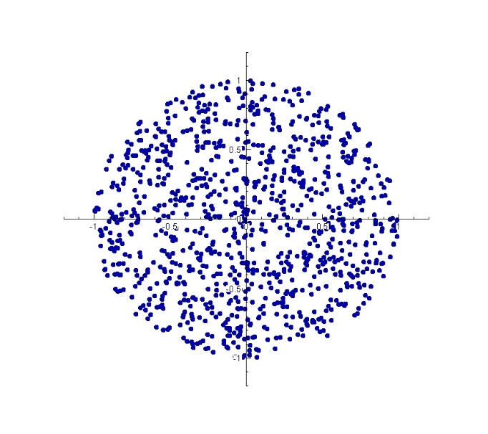
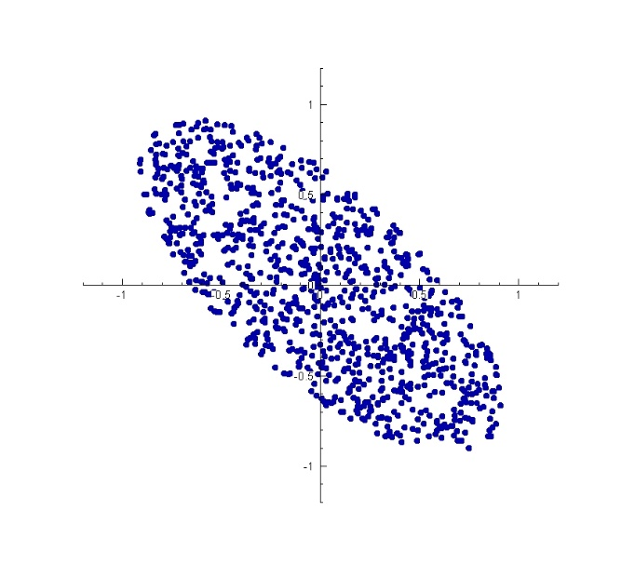
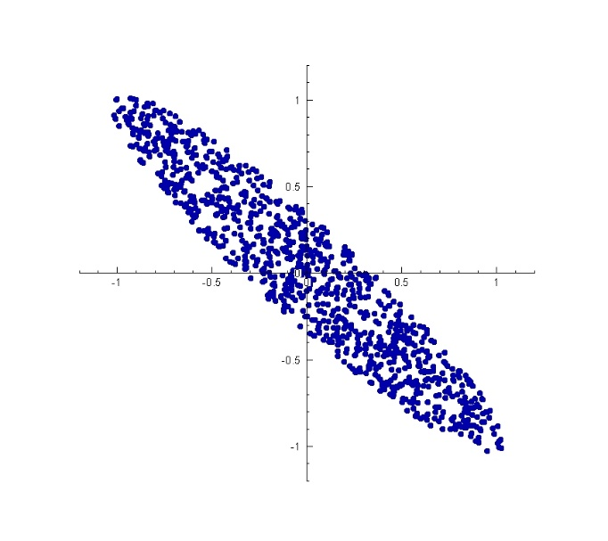
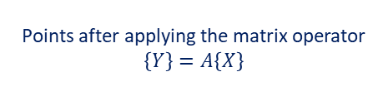
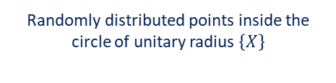
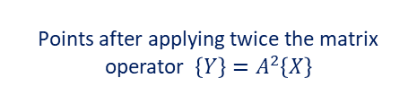
Iterative Methods-Subspace Projection Methods
Single Vector Iteration Methods. Power Method.
Used to find the dominant/extremal eigenvector of a matrix:
Randomly distributed points inside the circle of unitary radius $\left\{X\right\}$
Points after applying the matrix operator $\left\{Y\right\}=A\left\{X\right\}$
Points after applying twice the matrix operator $\left\{Y\right\}=A^{2}\left\{X\right\}$
$$A=\left(\begin{matrix}0.85 & \text{−}0.35 \\ \text{−}0.35 & 0.85\end{matrix}\right)$$

Slide 4

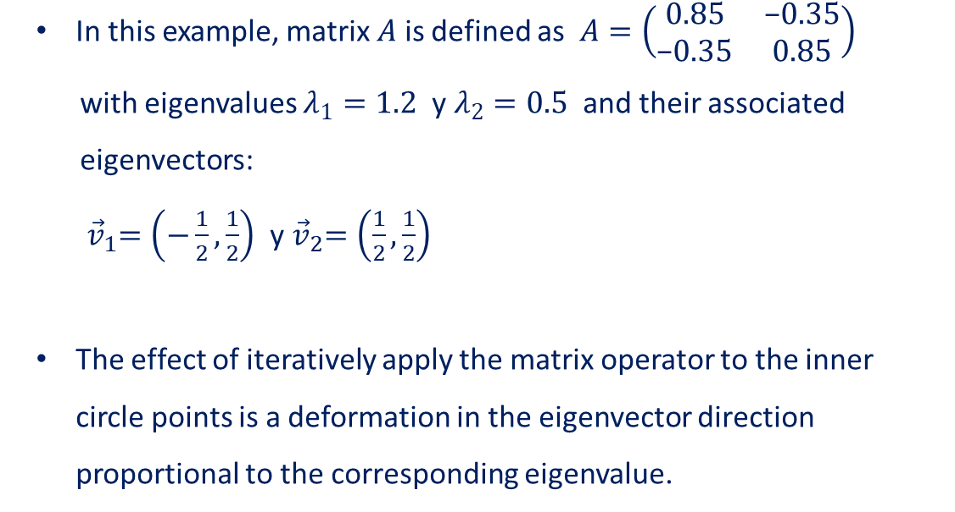



Iterative Methods-Subspace Projection Methods
Single Vector Iteration Methods. Power Method.
Used to find the dominant/extremal eigenvector of a matrix:
In this example, matrix $A$ is defined as $A=\left(\begin{matrix}0.85 & \text{−}0.35 \\ \text{−}0.35 & 0.85\end{matrix}\right)$
with eigenvalues $λ_{1}=1.2$ y $λ_{2}=0.5$ and their associated
eigenvectors:
${ \vec{v}}_{1}=\left(\text{−}\frac{1}{2},\frac{1}{2}\right)$ y${ \vec{v}}_{2}=\left(\frac{1}{2},\frac{1}{2}\right)$
The effect of iteratively apply the matrix operator to the inner circle points is a deformation in the eigenvector direction proportional to the corresponding eigenvalue.
$${{λ_{1}}^{2}\vec{v}}_{1}$$
$${{λ_{2}}^{2}\vec{v}}_{2}$$
Points after applying twice the matrix operator $\left\{Y\right\}=A^{2}\left\{X\right\}$

Slide 5


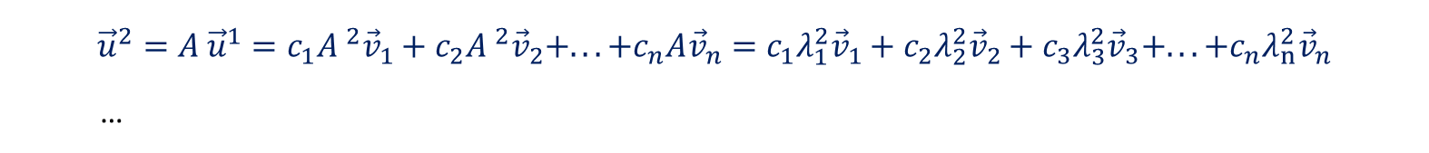

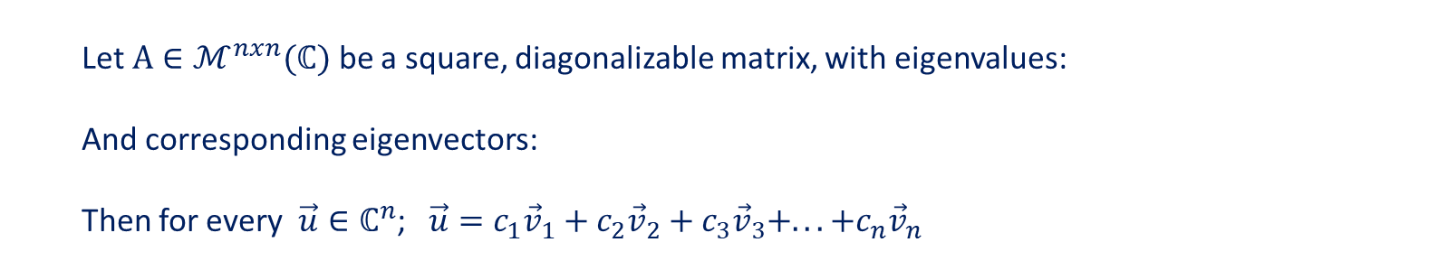
Iterative Methods-Subspace Projection Methods
Single Vector Iteration Methods. Power Method
Let $A∈ℳ^{nxn}(ℂ)$ be a square, diagonalizable matrix, with eigenvalues:
And corresponding eigenvectors:
Then for every $\vec{u}∈ℂ^{n}$; $\vec{u}=c_{1}{\vec{v}}_{1}+c_{2}{\vec{v}}_{2}+c_{3}{\vec{v}}_{3}+...+c_{n}{\vec{v}}_{n}$
$$\left|λ_{1}\right|>\left|λ_{2}\right|≥\left|λ_{3}\right|≥⋯≥\left|λ_{n}\right|$$
Mathematical
assumptions:
$B_{V}=\left\{{\vec{v}}_{1},{\vec{v}}_{2},{\vec{v}}_{3},...,{\vec{v}}_{n}\right\}$ with $A{\vec{v}}_{i}={λ_{i}\vec{v}}_{i}$
Power method
The method starts picking any vector ${\vec{u}}^{0}$ and succesively multiply it by the matrix operator:
$${\vec{u}}^{0}=c_{1}{\vec{v}}_{1}+c_{2}{\vec{v}}_{2}+c_{3}{\vec{v}}_{3}+...+c_{n}{\vec{v}}_{n}$$
$${\vec{u}}^{1}=A {\vec{u}}^{0}=c_{1}A{\vec{v}}_{1}+c_{2}A{\vec{v}}_{2}+c_{3}A{\vec{v}}_{3}+...+c_{n}A{\vec{v}}_{n}=c_{1}λ_{1}{\vec{v}}_{1}+c_{2}λ_{2}{\vec{v}}_{2}+c_{3}λ_{3}{\vec{v}}_{3}+...+c_{n}λ_{n}{\vec{v}}_{n}$$
$${\vec{u}}^{2}=A {\vec{u}}^{1}=c_{1}A ^{2}{\vec{v}}_{1}+c_{2}A ^{2}{\vec{v}}_{2}+...+c_{n}A{\vec{v}}_{n}=c_{1}λ_{1}^{2}{\vec{v}}_{1}+c_{2}λ_{2}^{2}{\vec{v}}_{2}+c_{3}λ_{3}^{2}{\vec{v}}_{3}+...+c_{n}λ_{n}^{2}{\vec{v}}_{n}$$
…
$${\vec{u}}^{k}=A ^{k}{\vec{u}}^{0}=c_{1}λ_{1}^{k}{\vec{v}}_{1}+c_{2}λ_{2}^{k}{\vec{v}}_{2}+c_{3}λ_{3}^{k}{\vec{v}}_{3}+...+c_{n}λ_{n}^{k}{\vec{v}}_{n}=λ_{1}^{k}\left(c_{1}{\vec{v}}_{1}+c_{2}{\left(\frac{λ_{2}}{λ_{1}}\right)}^{k}{\vec{v}}_{2}+c_{3}{\left(\frac{λ_{3}}{λ_{1}}\right)}^{k}{\vec{v}}_{3}+...+c_{n}{\left(\frac{λ_{n}}{λ_{1}}\right)}^{k}{\vec{v}}_{n}\right)$$

Slide 6



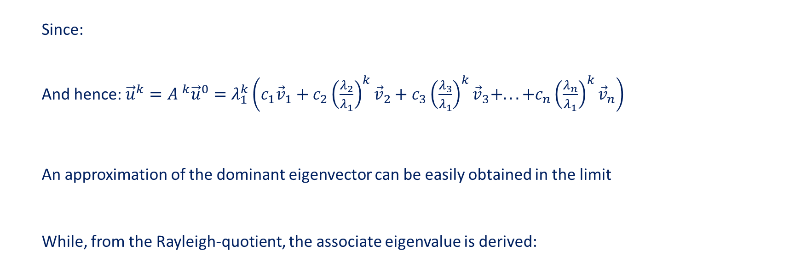


Iterative Methods-Subspace Projection Methods
Single Vector Iteration Methods. Power Method
Since:
And hence:${\vec{u}}^{k}=A ^{k}{\vec{u}}^{0}=λ_{1}^{k}\left(c_{1}{\vec{v}}_{1}+c_{2}{\left(\frac{λ_{2}}{λ_{1}}\right)}^{k}{\vec{v}}_{2}+c_{3}{\left(\frac{λ_{3}}{λ_{1}}\right)}^{k}{\vec{v}}_{3}+...+c_{n}{\left(\frac{λ_{n}}{λ_{1}}\right)}^{k}{\vec{v}}_{n}\right)$
An approximation of the dominant eigenvector can be easily obtained in the limit
While, from the Rayleigh-quotient, the associate eigenvalue is derived:
$\left|λ_{1}\right|>\left|λ_{2}\right|≥\left|λ_{3}\right|≥⋯≥\left|λ_{n}\right|$, ${\left(\frac{λ_{i}}{λ_{1}}\right)}^{k}→0; k→∞$
$$\lim_{k→∞}{A ^{k}{\vec{u}}^{0}}={λ_{1}^{k}c}_{1}{\vec{v}}_{1}$$
$$\boxed{{\vec{v}}_{1}\sim \frac{{\vec{u}}_{k}}{\left\|{\vec{u}}_{k}\right\|}=\frac{A^{k}{\vec{u}}^{0}}{\left\|A^{k}{\vec{u}}^{0}\right\|}}$$
$R\left({\vec{v}}_{1}\right)=\frac{{{\vec{v}}_{1}}^{T}A{\vec{v}}_{1}}{{{\vec{v}}_{1}}^{T}{\vec{v}}_{1}}=\frac{{{\vec{v}}_{1}}^{T}λ_{1}{\vec{v}}_{1}}{{{\vec{v}}_{1}}^{T}{\vec{v}}_{1}}=\frac{λ_{1}{\left\|{\vec{v}}_{1}\right\|}^{2}}{{\left\|{\vec{v}}_{1}\right\|}^{2}}=λ_{1}$

Slide 7


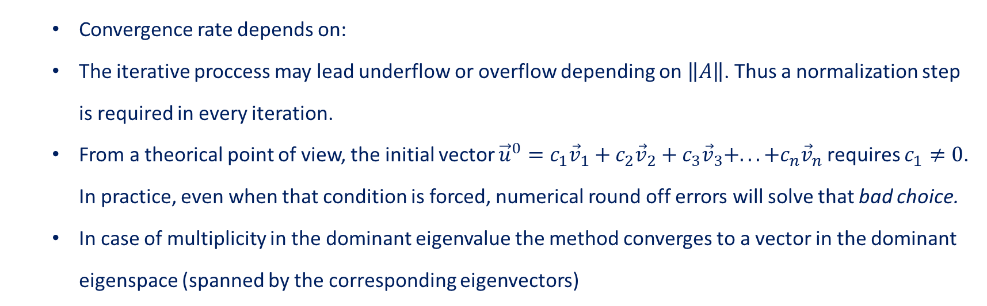
Iterative Methods-Subspace Projection Methods
Single Vector Iteration Methods. Power Method
$${\vec{u}}^{k}=A ^{k}{\vec{u}}^{0}=λ_{1}^{k}\left(c_{1}{\vec{v}}_{1}+c_{2}{\left(\frac{λ_{2}}{λ_{1}}\right)}^{k}{\vec{v}}_{2}+c_{3}{\left(\frac{λ_{3}}{λ_{1}}\right)}^{k}{\vec{v}}_{3}+...+c_{n}{\left(\frac{λ_{n}}{λ_{1}}\right)}^{k}{\vec{v}}_{n}\right)$$
Convergence rate depends on:
The iterative proccess may lead underflow or overflow depending on $\left\|A\right\|$. Thus a normalization step is required in every iteration.
From a theorical point of view, the initial vector ${\vec{u}}^{0}=c_{1}{\vec{v}}_{1}+c_{2}{\vec{v}}_{2}+c_{3}{\vec{v}}_{3}+...+c_{n}{\vec{v}}_{n}$ requires $c_{1}≠0$. In practice, even when that condition is forced, numerical round off errors will solve that bad choice.
In case of multiplicity in the dominant eigenvalue the method converges to a vector in the dominant eigenspace (spanned by the corresponding eigenvectors)
$$\frac{λ_{2}}{λ_{1}}$$
Power method Convergence issues:

Slide 8



Iterative Methods-Subspace Projection Methods
Single Vector Iteration Methods. Power Method
Chose ${\vec{u}}^{0}$ so that $\left\|{\vec{u}}^{0}\right\|$=1
Iterative proccess (loop)
for $k=1,2,…$do
${\vec{u}}^{k}=A{\vec{u}}^{k−1}$
${\vec{u}}^{k}=\frac{{\vec{u}}^{k}}{\left\|{\vec{u}}^{k}\right\|}$ (Normalization)
if (Convergence) exit
end
Use Rayleigh-Quotient to calculate the eigenvalue.
Power method Algorithm:
$$λ=\frac{{{\vec{u}}^{k}}^{T}A{\vec{u}}^{k}}{{\left\|{\vec{u}}^{k}\right\|}^{2}}$$

Slide 9
Iterative Methods-Subspace Projection Methods
Single Vector Iteration Methods. Modifications to the Power Method.
Inverse Power Method. This variant is used for computing the smallest eigenvalue.
Shift-and-Invert Iteration. This method is applied to find the eigenvalue closest to a specific value
Deflation Procedure. To compute the second largest (or smallest if combined with previous techniques) eigenvalue.
Subspace Iteration. To compute several eigenvalues and the associated invariant subspace.

Slide 10


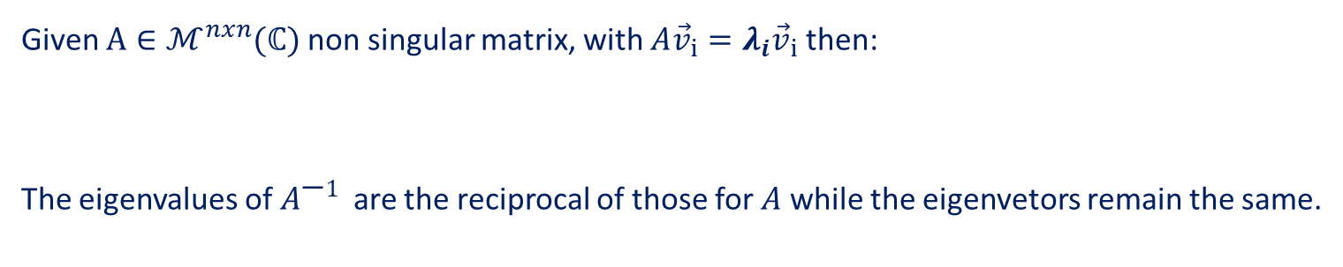
Iterative Methods-Subspace Projection Methods
1.2. Single Vector Iteration Methods. Shift-and-Invert Power Method
Given $A∈ℳ^{nxn}(ℂ)$ non singular matrix, with $A{\vec{v}}_{i}={λ_{i}\vec{v}}_{i}$ then:
The eigenvalues of $A^{\text{−}1}$ are the reciprocal of those for $A$ while the eigenvetors remain the same.
$A{\vec{v}}_{i}={λ_{i}\vec{v}}_{i}→A^{\text{−}1}A{\vec{v}}_{i}={{A^{\text{−}1}λ}_{i}\vec{v}}_{i}→\frac{1}{λ_{i}}{\vec{v}}_{i}$=${A^{\text{−}1}\vec{v}}_{i}$
Moreover, if $\left|λ_{1}\right|>\left|λ_{2}\right|≥⋯≥\left|λ_{n−1}\right|>\left|λ_{n}\right|$ then $\left|\frac{1}{λ_{n}}\right|>\left|\frac{1}{λ_{n−1}}\right|≥⋯≥\left|\frac{1}{λ_{2}}\right|≥\left|\frac{1}{λ_{1}}\right|$
So the power method applied to $A^{\text{−}1}$will converge to the eigenvector associated to the smallest eigenvalue in magnitude.

Slide 11

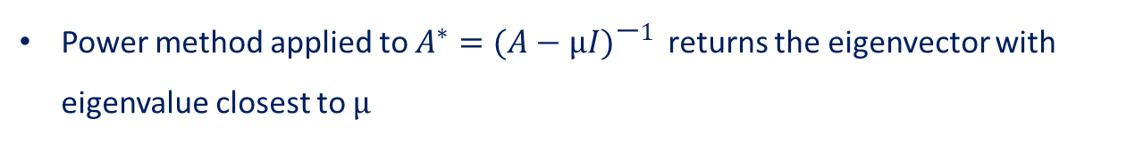
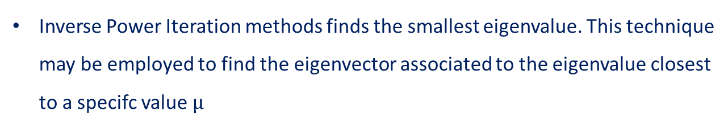
Iterative Methods-Subspace Projection Methods
1.2. Single Vector Iteration Methods. Shift-and-Invert Power Method
Inverse Power Iteration methods finds the smallest eigenvalue. This technique may be employed to find the eigenvector associated to the eigenvalue closest to a specifc value $μ$
$$μ$$
$$\left(A−μI\right){\vec{v}}_{i}={A{\vec{v}}_{i}−μI{{\vec{v}}_{i}=λ}_{i}\vec{v}}_{i}−μ{\vec{v}}_{i}=\left(λ_{i}−μ\right){\vec{v}}_{i}$$
Power method applied to $A^{∗}={(A−μI)}^{\text{−}1}$ returns the eigenvector with eigenvalue closest to $μ$

Slide 12



Iterative Methods-Subspace Projection Methods
1.2. Single Vector Iteration Methods. Shift-and-Invert Power Method
Chose ${\vec{u}}^{0}$ so that $\left\|{\vec{u}}^{0}\right\|$=1
Iterative proccess (loop)
for $k=1,2,…$do
${\vec{u}}^{k}={(A−μI)}^{\text{−}1}{\vec{u}}^{k−1}$
${\vec{u}}^{k}=\frac{{\vec{u}}^{k}}{\left\|{\vec{u}}^{k}\right\|}$ (Normalization)
if (Convergence) exit
end
Use Rayleigh-Quotient to calculate the eigenvalue.
Solve a linear system in each step
$$\left(A−μI\right){\vec{u}}^{k}={\vec{u}}^{k−1}$$
Algorithm:
$$λ=\frac{{{\vec{u}}^{k}}^{T}A{\vec{u}}^{k}}{{\left\|{\vec{u}}^{k}\right\|}^{2}}$$

Slide 13



Iterative Methods-Subspace Projection Methods
1.3. Single Vector Iteration Methods. Deflation Procedure
A deflation procedure is to apply a modification to matrix $A$ to avoid convergence to the leading eigenvector already computed ${\vec{v}}_{1}$.
$$A^{∗}=A−λ_{1}{\vec{v}}_{1}{{\vec{v}}_{1}}^{T}$$
This transformation shifts the dominant eigenvalue to zero. So, second eigenvalue in magnitude becomes dominant.
$$A^{∗}{\vec{v}}_{1}=\left(A−λ_{1}{\vec{v}}_{1}{{\vec{v}}_{1}}^{T}\right){\vec{v}}_{1}=A{\vec{v}}_{1}−λ_{1}{\vec{v}}_{1}=0$$
The deflation procedure preserves the rest of the eigenvectors.
$A^{∗}{\vec{v}}_{j}=\left(A−λ_{1}{\vec{v}}_{1}{{\vec{v}}_{1}}^{T}\right){\vec{v}}_{j}=A{\vec{v}}_{j}=λ_{j}{\vec{v}}_{j}$ Remember ${{\vec{v}}_{1}}^{T}{\vec{v}}_{j}=0$ if $j≠1$

Slide 14

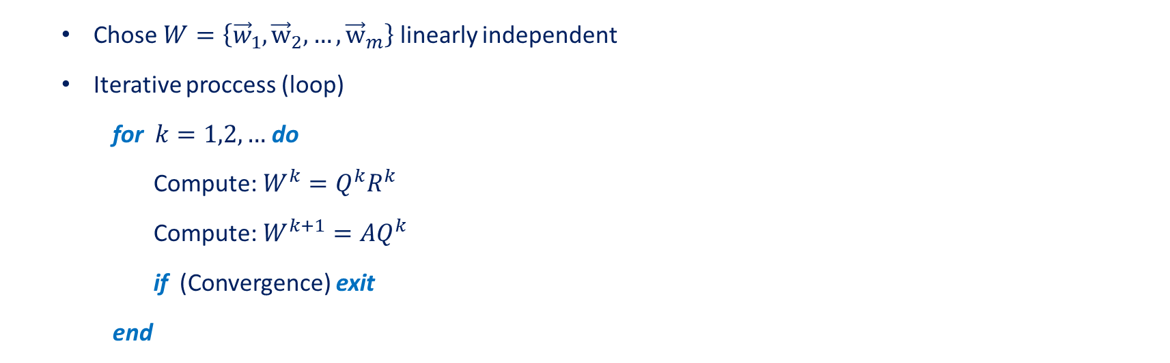

Iterative Methods-Subspace Projection Methods
1.4. Single Vector Iteration Methods. Subspace Iteration
To compute several eigenvectors the Power Method is generalized starting with a set of linearly independent vectors:
$$W=\left\{{\vec{w}}_{1},{\vec{w}}_{2},…, {\vec{w}}_{m}\right\}$$
The fundamental part of this procedure is to ensure that the set of vectors remain linearly independent after every step. This is done by QR factorization of $W^{k}$ (Orthogonalization)
Chose $W=\left\{{\vec{w}}_{1},{\vec{w}}_{2},…, {\vec{w}}_{m}\right\}$ linearly independent
Iterative proccess (loop)
for $k=1,2,…$do
Compute:$W^{k}=Q^{k}R^{k}$
Compute:$W^{k+1}=AQ^{k}$
if (Convergence) exit
end
QR factorization
Algorithm:

Slide 15

Iterative Methods-Subspace Projection Methods
Single Vector Iteration Methods.
Power Methods are fast and simple for single eigenvalues calculations.
These methods are flexible and can be easily modified to find more eigenvalues.
Numerically Stable.
But….
There are complications for eigenvalues with geometric multiplicity greater than 1.
Needs initial guess to find non-dominant eigenvectors.
No competitive in time consuming when a big part of the eigenspectrum is sought.

Slide 16

Numerical Methods for Eigenvalue Problems
Mathematical Properties
of the Problem
Single Vector Iteration Methods
Full Spectrum Computation
Subspace Projection Methods
Most Adequate Method
Computational Requirements
Desired Spectral Information

Slide 17
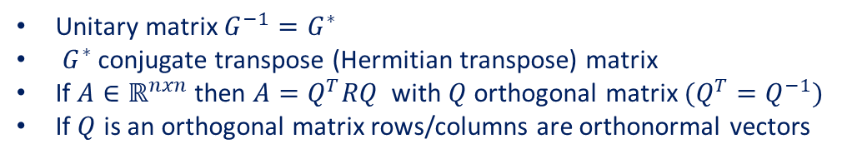
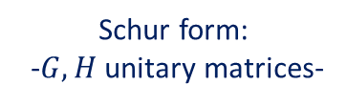

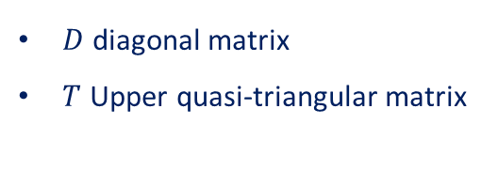






Iterative Methods-Subspace Projection Methods
Full spectrum computation.
The idea behind these type of methods is to perform a similarity transformation in the matrix operator to some simpler form, that yields the eigenvalues and eigenvectors directly.
$D$ diagonal matrix
$T$ Upper quasi-triangular matrix
Schur form:
-$G,H$ unitary matrices-
Jacobi
Symmetric matrices
$$A=G^{∗}DG$$
$$T=\left(\begin{matrix} & \\ & \begin{matrix} & \\ \begin{matrix} \\ \end{matrix} & \end{matrix}\end{matrix}\right)$$
LR-QR
Unsymmetric matrices
$$A=H^{∗}TH$$
If $λ_{1},…λ_{n}∈ℝ$ then $T$is upper triangular
$$T=\left(\begin{matrix} & \\ & \begin{matrix} & \\ \begin{matrix} \\ \end{matrix} & \end{matrix}\end{matrix}\right)$$
Unitary matrix ${G^{−1}=G}^{∗}$
$G^{∗}$ conjugate transpose (Hermitian transpose) matrix
If $A∈ℝ^{nxn}$ then $A=Q^{T}RQ$ with $Q$ orthogonal matrix $(Q^{T}=Q^{−1})$
If $Q$ is an orthogonal matrix rows/columns are orthonormal vectors
If $λ_{1}∈ℂ⟶$ 2x2 blocks in the diagonal

Slide 18


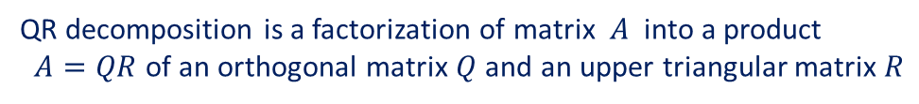

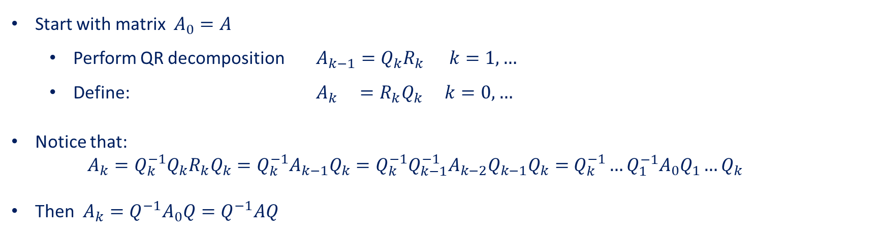
Iterative Methods-Subspace Projection Methods
Full spectrum computation. QR Algorithm
QR Algorithm. Idea: Iteratively perform QR decompositions to obtain a upper triangular* matrix similar to $A$
QR decomposition is a factorization of matrix $A$ into a product
$A=QR$ of an orthogonal matrix $Q$ and an upper triangular matrix $R$
Basic QR Algorithm:
Start with matrix $A_{0}=A$
Perform QR decomposition $A_{k−1}=Q_{k}R_{k }$ $k=1,…$
Define: $A_{k} =R_{k}Q_{k}$ $k=0,…$
Notice that:
$A_{k}=Q_{k}^{−1}Q_{k}R_{k}Q_{k}=Q_{k}^{−1}A_{k−1}Q_{k}=Q_{k}^{−1}Q_{k−1}^{−1}A_{k−2}Q_{k−1}Q_{k}=$ $Q_{k}^{−1}…Q_{1}^{−1}A_{0}Q_{1}…Q_{k}$
Then $A_{k}=Q^{−1}A_{0}Q=Q^{−1}AQ$
$$Q^{−1}$$
$$Q$$

Slide 19

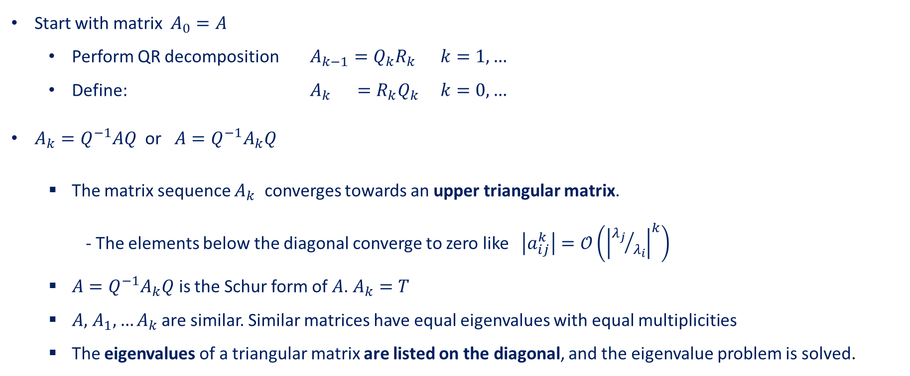
Iterative Methods-Subspace Projection Methods
Full spectrum computation. QR Algorithm
Basic QR Algorithm:
Start with matrix $A_{0}=A$
Perform QR decomposition $A_{k−1}=Q_{k}R_{k }$ $k=1,…$
Define: $A_{k} =R_{k}Q_{k}$ $k=0,…$
$A_{k}=Q^{−1}AQ$ or $A=Q^{−1}A_{k}Q$
The matrix sequence $A_{k}$ converges towards an upper triangular matrix.
- The elements below the diagonal converge to zero like $\left|a_{ij}^{k}\right|=𝒪\left({\left|{λ_{j}}/{λ_{i}}\right|}^{k}\right)$
$A=Q^{−1}A_{k}Q$ is the Schur form of $A$. $A_{k}=T$
$A,$ $A_{1},…A_{k}$ are similar. Similar matrices have equal eigenvalues with equal multiplicities
The eigenvalues of a triangular matrix are listed on the diagonal, and the eigenvalue problem is solved.

Slide 20
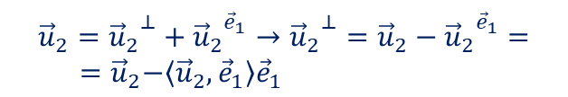


Iterative Methods-Subspace Projection Methods
Full spectrum computation. QR Algorithm
QR decomposition
Gram Schmidt: From a linearly independent set, each element is modified substracting its projection onto the previously calculated orthogonal vectors
$A_{0}=A$; $U_{0}=I$
Iterative process (loop)
for $k=1,2,…$do
Compute:$A_{k−1}=Q_{k}R_{k }$
Compute: $A_{k} =R_{k}Q_{k}$
Compute: $U_{k} =U_{k−1}Q_{k}$
if (Convergence) exit
End
Set $T=A_{k}; U=U_{k}$
$${\vec{u}}_{2}={{\vec{u}}_{2}}^{⊥}+{{\vec{u}}_{2}}^{{\vec{e}}_{1}}→{{\vec{u}}_{2}}^{⊥}={\vec{u}}_{2}−{{\vec{u}}_{2}}^{{\vec{e}}_{1}}=$$
${ =\vec{u}}_{2}−\left\langle {\vec{u}}_{2},{\vec{e}}_{1}\right\rangle {\vec{e}}_{1}$
Algorithm:
Simple algorithm. Great for academic purpose.
Very sensitive to rounding errors. Numerically unstable
Slow computations
Computes an upper triangular matrix $T$ and a unitary $U$such that $UTU^{∗}$ is the Schur decomposition of $A$

Slide 21








Iterative Methods-Subspace Projection Methods
Full spectrum computation. QR Algorithm
QR decomposition
Householder reflection: Columns of initial matrix are reflected about some subspace in such a way that the desired coordinates disappear.
$A_{0}=A$; $U_{0}=I$
Iterative process (loop)
for $k=1,2,…$do
Compute:$A_{k−1}=Q_{k}R_{k }$
Compute: $A_{k} =R_{k}Q_{k}$
Compute: $U_{k} =U_{k−1}Q_{k}$
if (Convergence) exit
End
Set $T=A_{k}; U=U_{k}$
$$H=(I−2\vec{u}{\vec{u}}^{T})$$
$$\vec{v}$$
Algorithm:
$$\vec{u}{\vec{u}}^{T}\vec{v}$$
$$\vec{u}$$
$$H\vec{v}$$
$H$ is hermitian and unitary. $H^{2}=I$
$H_{1}$ is built to satisfy $H_{1}A=$
$H_{n}H_{n−1}…H_{1}A=R$
$$\left(\begin{matrix} & & \\ 0 & & \\ 0 & & \end{matrix}\right)$$
Computes an upper triangular matrix $T$ and a unitary $U$such that $UTU^{∗}$ is the Schur decomposition of $A$

Slide 22

Iterative Methods-Subspace Projection Methods
Full spectrum computation. QR Algorithm
QR decomposition
Householder reflection: Columns of initial matrix are reflected about some subspace in such a way that the desired coordinates disappear.
$A_{0}=A$; $U_{0}=I$
Iterative process (loop)
for $k=1,2,…$do
Compute:$A_{k−1}=Q_{k}R_{k }$
Compute: $A_{k} =R_{k}Q_{k}$
Compute: $U_{k} =U_{k−1}Q_{k}$
if (Convergence) exit
End
Set $T=A_{k}; U=U_{k}$
$$H=(I−2\vec{u}{\vec{u}}^{T})$$
$$\vec{v}$$
Algorithm:
$$\vec{u}$$
$$H\vec{v}$$
Multiplication with Householder is cheap.
Numerically stable.
Difficult to parallelize
Computes an upper triangular matrix $T$ and a unitary $U$such that $UTU^{∗}$ is the Schur decomposition of $A$

Slide 23
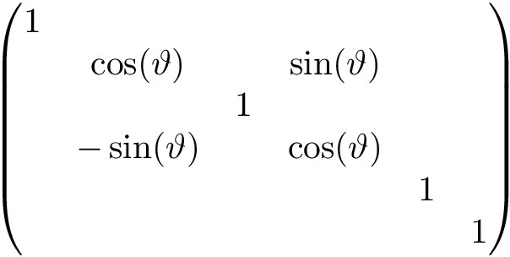


Iterative Methods-Subspace Projection Methods
Full spectrum computation. QR Algorithm
QR decomposition
Givens rotation: Similar purpose to zeroes an element in the subdiagonal of the matrix in each iteration, forming the R matrix.
Instead employing reflections the transformation is performed using rotations
$A_{0}=A$; $U_{0}=I$
Iterative process (loop)
for $k=1,2,…$do
Compute:$A_{k−1}=Q_{k}R_{k }$
Compute: $A_{k} =R_{k}Q_{k}$
Compute: $U_{k} =U_{k−1}Q_{k}$
if (Convergence) exit
End
Set $T=A_{k}; U=U_{k}$
Algorithm:
$$G=$$
Numerically stable
More easily parallelized than Householder reflections .
Complex to implement.
Computes an upper triangular matrix $T$ and a unitary $U$such that $UTU^{∗}$ is the Schur decomposition of $A$

Slide 24


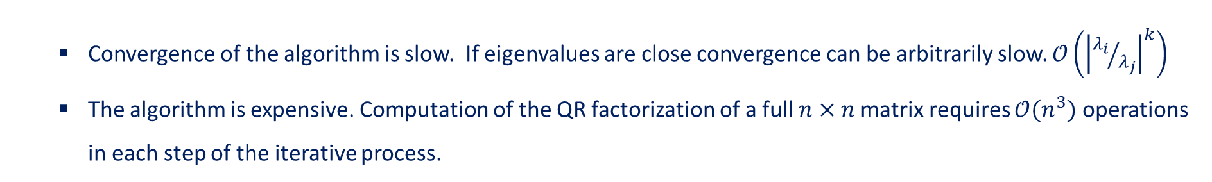
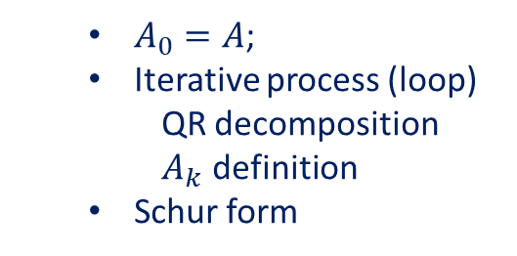


Iterative Methods-Subspace Projection Methods
Full spectrum computation. QR Algorithm
Preprocessing. Similar transformation
Basic QR Algorithm
$A_{0}=A$;
Iterative process (loop)
QR decomposition
$A_{k}$ definition
Schur form
$$A$$
$$B$$
Convergence of the algorithm is slow. If eigenvalues are close convergence can be arbitrarily slow. $𝒪\left({\left|{λ_{i}}/{λ_{j}}\right|}^{k}\right)$
The algorithm is expensive. Computation of the QR factorization of a full $n×n$matrix requires $𝒪(n^{3})$ operations in each step of the iterative process.
QR algorithm can be more efficient by a preprocessing step. QR factorization is much faster when applied to Hessenberg form matrices. This structure is preserved by the QR algorithm.

Slide 25




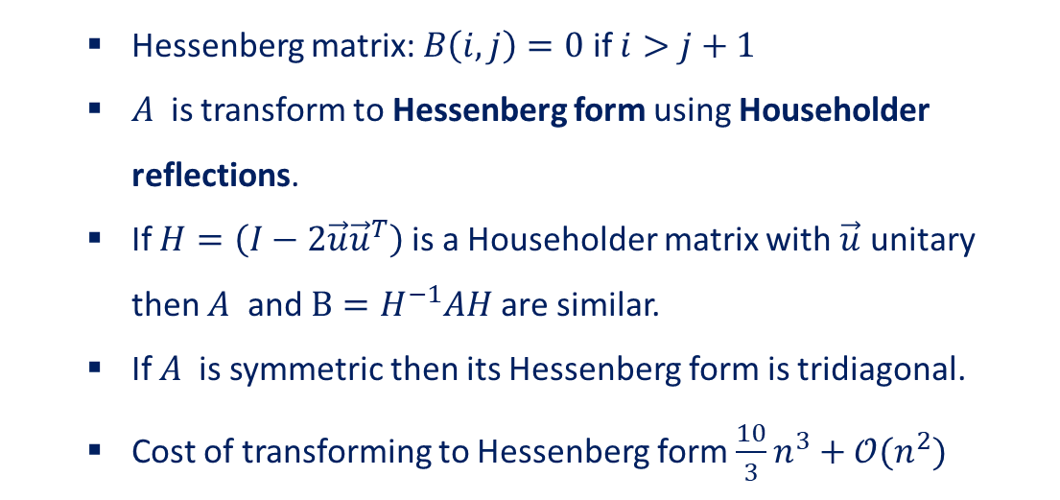
Iterative Methods-Subspace Projection Methods
Full spectrum computation. QR Algorithm
Preprocessing. Similar transformation
$$A$$
$$B$$
Hessenberg matrix: $B\left(i,j\right)=0$ if $i>j+1$
$A$ is transform to Hessenberg form using Householder reflections.
If $H=\left(I−2\vec{u}{\vec{u}}^{T}\right)$ is a Householder matrix with $\vec{u}$ unitary then $A$ and $B=H^{−1}AH$are similar.
If $A$ is symmetric then its Hessenberg form is tridiagonal.
Cost of transforming to Hessenberg form $\frac{10}{3}n^{3}+𝒪(n^{2})$

Slide 26
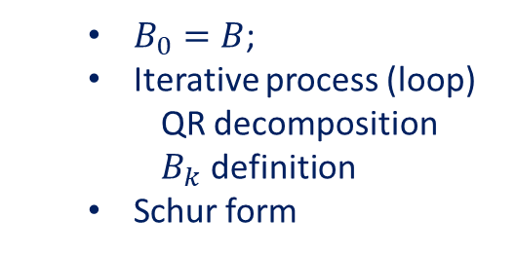
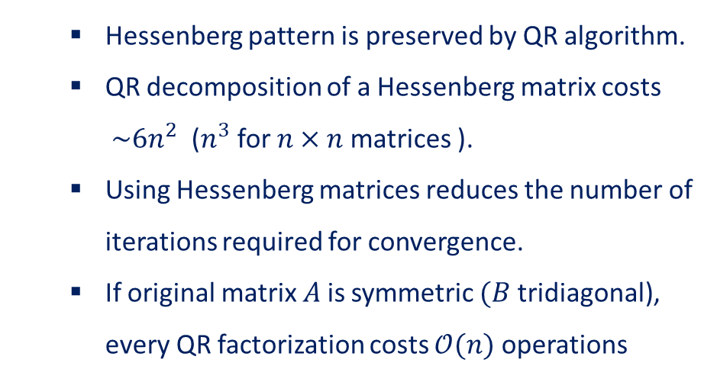
Iterative Methods-Subspace Projection Methods
Full spectrum computation. QR Algorithm
Preprocessing. Similar transformation
Basic QR Algorithm in Hessenberg form
$B_{0}=B$;
Iterative process (loop)
QR decomposition
$B_{k}$ definition
Schur form
$$A$$
$$B$$
Hessenberg matrix: $B\left(i,j\right)=0$ if $i>j+1$
$A$ is transform to Hessenberg form using Householder reflections.
If $H=\left(I−2\vec{u}{\vec{u}}^{T}\right)$ is a Householder matrix with $\vec{u}$ unitary then $A$ and $B=H^{−1}AH$are similar.
If $A$ is symmetric then its Hessenberg form is tridiagonal.
Cost of transforming to Hessenberg form $\frac{10}{3}n^{3}+𝒪(n^{2})$
Hessenberg pattern is preserved by QR algorithm.
QR decomposition of a Hessenberg matrix costs $\sim 6n^{2}$ ($n^{3}$ for $n×n$matrices ).
Using Hessenberg matrices reduces the number of iterations required for convergence.
If original matrix $A$is symmetric $(B$ tridiagonal), every QR factorization costs $𝒪(n)$ operations

Slide 27
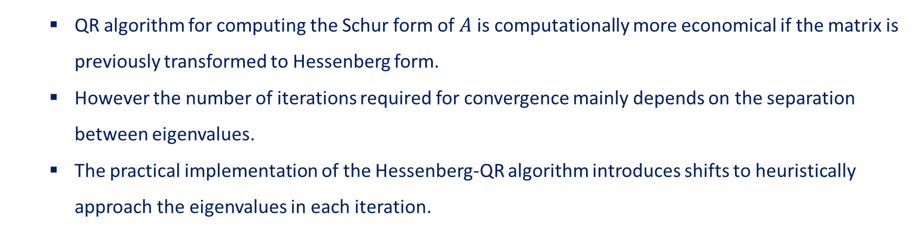
Iterative Methods-Subspace Projection Methods
Full spectrum computation. QR Algorithm
Preprocessing. Similar transformation
Basic QR Algorithm in Hessenberg form
$B_{0}=B$;
Iterative process (loop)
QR decomposition
$B_{k}$ definition
Schur form
$$A$$
$$B$$
QR algorithm for computing the Schur form of $A$ is computationally more economical if the matrix is previously transformed to Hessenberg form.
However the number of iterations required for convergence mainly depends on the separation between eigenvalues.
The practical implementation of the Hessenberg-QR algorithm introduces shifts to heuristically approach the eigenvalues in each iteration.

Slide 28
Numerical Methods for Eigenvalue Problems
Mathematical Properties
of the Problem
Single Vector Iteration Methods
Full Spectrum Computation
Subspace Projection Methods
Most Adequate Method
Computational Requirements
Desired Spectral Information

Slide 29


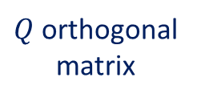




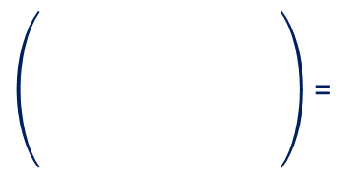

Iterative Methods-Subspace Projection Methods
Subspace Projection Methods.
Used to compute some eigenvectors and eigenvalues of a matrix.
Subspace Projection Methods
Orthogonal
Transformations
Gram-Schmidt Process
=
$$A$$
$$Q$$
$$H$$
$$Q^{∗}$$
Input
matrix
$Q$ orthogonal
matrix
Hessenberg
form
Unknowns

Slide 30



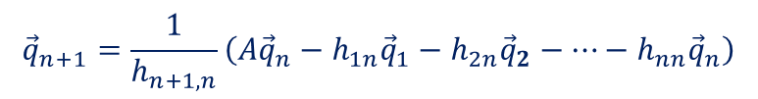
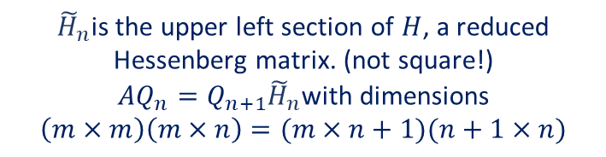


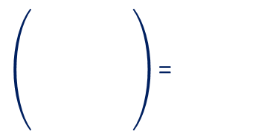
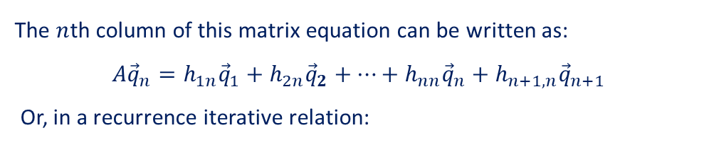















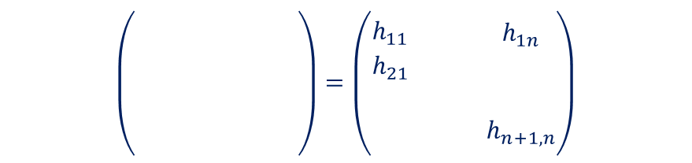
Iterative Methods-Subspace Projection Methods
Subspace Projection Methods.
=
Equivalent
expression
$$A$$
$$Q$$
$$Q$$
$$H$$
Considering the first $n$ columns of matrix $Q$
=
$$\left(\begin{matrix}\begin{matrix}{}_{}^{} & \\ & \end{matrix} & {}_{}^{} \\ \begin{matrix} & \\ {}_{}^{} & \end{matrix} & \end{matrix}\right)=\left(\begin{matrix}\begin{matrix}h_{11} & \\ h_{21} & \end{matrix} & \begin{matrix}h_{1n} \\ \end{matrix} \\ \begin{matrix} & \\ & \end{matrix} & \begin{matrix} \\ h_{n+1,n}\end{matrix}\end{matrix}\right)$$
$$A$$
$$Q_{n}$$
$$Q_{n+1}$$
$${\tilde{H}}_{n}$$
with
$${\tilde{H}}_{n}$$
$${\tilde{H}}_{n}$$
$$H_{n}$$
The $n$th column of this matrix equation can be written as:
$A{\vec{q}}_{n}=h_{1n}{\vec{q}}_{1}+h_{2n}{\vec{q}}_{2}+…+h_{nn}{\vec{q}}_{n}+h_{n+1,n}{\vec{q}}_{n+1}$
Or, in a recurrence iterative relation:
${\tilde{H}}_{n}$is the upper left section of $H$, a reduced Hessenberg matrix. (not square!)
$AQ_{n}=Q_{n+1}{\tilde{H}}_{n}$with dimensions
$$\left(m×m\right)\left(m×n\right)=(m×n+1)(n+1×n)$$
$${\vec{q}}_{n+1}=\frac{1}{h_{n+1,n}}\left(A{\vec{q}}_{n}−h_{1n}{\vec{q}}_{1}−h_{2n}{\vec{q}}_{2}−…−h_{nn}{\vec{q}}_{n}\right)$$
While orthonormality of column vectors $Q_{n}$ of implies
These equations are the core of the Arnoldi iteration method
$h_{n+1,n}=\left\|A{\vec{q}}_{n}−h_{1n}{\vec{q}}_{1}−h_{2n}{\vec{q}}_{2}−…−h_{nn}{\vec{q}}_{n}\right\|$ and ${\vec{q}}_{j}^{∗}A{\vec{q}}_{n}=h_{jn}$

Slide 31





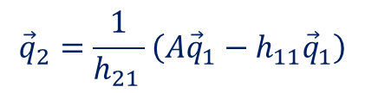












Iterative Methods-Subspace Projection Methods
Subspace Projection Methods. Arnoldi-Lanczos Method
=
Chose ${\vec{q}}_{1}$ so that $\left\|{\vec{q}}_{1}\right\|$=1
Iterative process (loop)
for $n=1,2,…$do
Compute:$v=A{\vec{q}}_{n}$
for $j=1,…,n$ do
Compute: $h_{jn}={\vec{q}}_{j}^{∗}v$
Compute: $v=v−h_{jn}{\vec{q}}_{j}$
end
$h_{n+1,n}=\left\|v\right\|$
${\vec{q}}_{n+1}=v/{h_{n+1,n}}$
end
$${\tilde{H}}_{n}$$
$$A$$
$$Q_{n}$$
$$Q_{n+1}$$
$$H_{n}$$
$$n=1$$
$$v=A{\vec{q}}_{1}$$
Algorithm:
$$j=1$$
$$h_{11}={\vec{q}}_{1}^{∗}A{\vec{q}}_{1}$$
$$v=A{\vec{q}}_{1}−h_{11}{\vec{q}}_{1}$$
$$h_{21}=\left\|A{\vec{q}}_{1}−h_{11}{\vec{q}}_{1}\right\|$$
$${\vec{q}}_{2}=\frac{1}{h_{21 }}\left(A{\vec{q}}_{1}−h_{11}{\vec{q}}_{1}\right)$$
knowns
unknowns

Slide 32

Iterative Methods-Subspace Projection Methods
Subspace Projection Methods. Arnoldi-Lanczos Method
=
Chose ${\vec{q}}_{1}$ so that $\left\|{\vec{q}}_{1}\right\|$=1
Iterative process (loop)
for $n=1,2,…$do
Compute:$v=A{\vec{q}}_{n}$
for $j=1,…,n$ do
Compute: $h_{jn}={\vec{q}}_{j}^{∗}v$
Compute: $v=v−h_{jn}{\vec{q}}_{j}$
end
$h_{n+1,n}=\left\|v\right\|$
${\vec{q}}_{n+1}=v/{h_{n+1,n}}$
end
$${\tilde{H}}_{n}$$
$$A$$
$$Q_{n}$$
$$Q_{n+1}$$
$$H_{n}$$
Iteration $n$ | Iteration $j$ | Computed values
$$n=1$$ | $$j=1$$ | $$h_{11}h_{21}{\vec{q}}_{2}$$
Algorithm:
knowns
unknowns

Slide 33



Iterative Methods-Subspace Projection Methods
Subspace Projection Methods. Arnoldi-Lanczos Method
=
Chose ${\vec{q}}_{1}$ so that $\left\|{\vec{q}}_{1}\right\|$=1
Iterative process (loop)
for $n=1,2,…$do
Compute:$v=A{\vec{q}}_{n}$
for $j=1,…,n$ do
Compute: $h_{jn}={\vec{q}}_{j}^{∗}v$
Compute: $v=v−h_{jn}{\vec{q}}_{j}$
end
$h_{n+1,n}=\left\|v\right\|$
${\vec{q}}_{n+1}=v/{h_{n+1,n}}$
end
$$Q_{n}$$
$${\tilde{H}}_{n}$$
$$A$$
$$Q_{n+1}$$
$$H_{n}$$
Iteration $n$ | Iteration $j$ | Computed values
$$n=1$$ | $$j=1$$ | $$h_{11}h_{21}{\vec{q}}_{2}$$
$$n=2$$ | $$j=1$$ | $$h_{12}$$
$$n=2$$ | $$j=2$$ | $$h_{22}h_{32}{\vec{q}}_{3}$$
Algorithm:
knowns
unknowns

Slide 34

Iterative Methods-Subspace Projection Methods
Subspace Projection Methods. Arnoldi-Lanczos Method
=
Chose ${\vec{q}}_{1}$ so that $\left\|{\vec{q}}_{1}\right\|$=1
Iterative process (loop)
for $n=1,2,…$do
Compute:$v=A{\vec{q}}_{n}$
for $j=1,…,n$ do
Compute: $h_{jn}={\vec{q}}_{j}^{∗}v$
Compute: $v=v−h_{jn}{\vec{q}}_{j}$
end
$h_{n+1,n}=\left\|v\right\|$
${\vec{q}}_{n+1}=v/{h_{n+1,n}}$
end
$$Q_{n}$$
$${\tilde{H}}_{n}$$
$$A$$
$$Q_{n+1}$$
$$H_{n}$$
Iteration $n$ | Iteration $j$ | Computed values
$$n=1$$ | $$j=1$$ | $$h_{11}h_{21}{\vec{q}}_{2}$$
$$n=2$$ | $$j=1$$ | $$h_{12}$$
$$n=2$$ | $$j=2$$ | $$h_{22}h_{32}{\vec{q}}_{3}$$
… | … | …
$$n=n$$ | $$j=n$$ | $$h_{nn}h_{n+1n}{\vec{q}}_{n+1}$$
Algorithm:
knowns
unknowns

Slide 35



Iterative Methods-Subspace Projection Methods
Subspace Projection Methods. Arnoldi-Lanczos Method
=
Chose ${\vec{q}}_{1}$ so that $\left\|{\vec{q}}_{1}\right\|$=1
Iterative process (loop)
for $n=1,2,…$do
Compute:$v=A{\vec{q}}_{n}$
for $j=1,…,n$ do
Compute: $h_{jn}={\vec{q}}_{j}^{∗}v$
Compute: $v=v−h_{jn}{\vec{q}}_{j}$
end
$h_{n+1,n}=\left\|v\right\|$
${\vec{q}}_{n+1}=v/{h_{n+1,n}}$
end
$$Q_{n}$$
$${\tilde{H}}_{n}$$
$$A$$
$$Q_{n+1}$$
$$H_{n}$$
But… Why does this iterative method work?
Gram-Schmidt process: Each new column of the unitary matrix element is calculated from $A{\vec{q}}_{n}$ substracting its projection onto the previously calculated orthonormal vectors.
Algorithm:
In fact the Arnoldi iteration may be seen as a QR factorization of the matrix:
$K_{n}=\left(\begin{matrix}\begin{matrix}\begin{matrix} \\ {\vec{q}}_{1} \\ \end{matrix} & \begin{matrix} \\ {A\vec{q}}_{1} \\ \end{matrix}\end{matrix} & \begin{matrix}⋯ & \begin{matrix} \\ {A^{n−1}\vec{q}}_{1} \\ \end{matrix}\end{matrix}\end{matrix}\right)$

Slide 36



Iterative Methods-Subspace Projection Methods
Subspace Projection Methods. Arnoldi-Lanczos Method
=
Chose ${\vec{q}}_{1}$ so that $\left\|{\vec{q}}_{1}\right\|$=1
Iterative process (loop)
for $n=1,2,…$do
Compute:$v=A{\vec{q}}_{n}$
for $j=1,…,n$ do
Compute: $h_{jn}={\vec{q}}_{j}^{∗}v$
Compute: $v=v−h_{jn}{\vec{q}}_{j}$
end
$h_{n+1,n}=\left\|v\right\|$
${\vec{q}}_{n+1}=v/{h_{n+1,n}}$
end
$$Q_{n}$$
$${\tilde{H}}_{n}$$
$$A$$
$$Q_{n+1}$$
$$H_{n}$$
$K_{n}=\left(\begin{matrix}\begin{matrix}\begin{matrix} \\ {\vec{q}}_{1} \\ \end{matrix} & \begin{matrix} \\ {A\vec{q}}_{1} \\ \end{matrix}\end{matrix} & \begin{matrix}⋯ & \begin{matrix} \\ {A^{n−1}\vec{q}}_{1} \\ \end{matrix}\end{matrix}\end{matrix}\right)$ is called the Krylov matrix.
$𝒦_{n}(A,\vec{q})=ℒ\left\{{\vec{q}}_{1},{A\vec{q}}_{1},…,{A^{n−1}\vec{q}}_{1}\right\}=ℒ\left\{{\vec{q}}_{1},{\vec{q}}_{2},…,{\vec{q}}_{n}\right\}$ Krylov subspace.
Algorithm:
$𝒦_{n}(A,\vec{q})$ is expected to span good approximations of the eigenvectors associated with eigenvalues with large module for the same reason that ${A^{n}\vec{q}}_{1}$ approximates the dominant eigenvector.

Slide 37



Iterative Methods-Subspace Projection Methods
Subspace Projection Methods. Eigenvalue Calculation
Matrix ${\tilde{H}}_{n}=\left(\begin{matrix}\begin{matrix}h_{11} & \\ h_{21} & \end{matrix} & \begin{matrix}h_{1n} \\ \end{matrix} \\ \begin{matrix} & \\ & \end{matrix} & \begin{matrix} \\ h_{n+1,n}\end{matrix}\end{matrix}\right)$ is not a square matrix, instead we use $H_{n}=Q_{n}^{∗}Q_{n+1}{\tilde{H}}_{n}=\left(\begin{matrix}\begin{matrix}h_{11} & \\ h_{21} & h_{22}\end{matrix} & \begin{matrix} & h_{1n} \\ & \end{matrix} \\ \begin{matrix} & \\ & \end{matrix} & \begin{matrix} & \\ h_{nn−1} & h_{nn }\end{matrix}\end{matrix}\right)$
Eigenvalues of $H_{n}$ are called the Arnoldi eigenvalue estimates or Ritz values, and they converge to the largest eigenvalues of $A$.
Eigenvalues of $H_{n}$ are computed with the QR algorithm.
(From Wikipedia) Arnoldi iteration convergence of Ritz values (red) to the eigenvalues (black) of a 400x400 matrix

Slide 38

Iterative Methods-Subspace Projection Methods
Subspace Projection Methods. Pros and Cons
The structure triangular/Hessenberg matrix is build column by column without transforming the matrix.
It can be stopped part-way, resulting a partial Hessenberg form.
Superlinear convergence behaviour of Ritz values.
But….
Spurious eigenvalues may appear for specific eigenvalue distributions. (no diagonalizable)
Irregular convergence: fast in the outer part of the spectrum, slow in the interior.
Finite precision computation in the recursive matrix multiplication deteriorates the orthonormality of ${\vec{q}}_{k}$

Slide 39





Iterative Methods-Subspace Projection Methods
Subspace Projection Methods. Lanczos Variations
Special Case
$A=A^{∗}$ Hermitian.
Hessenberg form
$H=Q^{∗}AQ$ is Tridiagonal
$$H=\left(\begin{matrix}\begin{matrix}α_{1} & β_{1} \\ β_{1} & α_{2}\end{matrix} & \begin{matrix} & 0 \\ & \end{matrix} \\ \begin{matrix} & \\ 0 & \end{matrix} & \begin{matrix} & β_{n−1} \\ β_{n−1} & α_{n}\end{matrix}\end{matrix}\right)$$
The recurrence iterative equation becomes:
$$A{\vec{q}}_{k}=β_{k−1}{\vec{q}}_{k−1}+α_{k}{\vec{q}}_{k}+β_{k}{\vec{q}}_{k+1}$$
3-term recursion.
Due to 3-term recursion no need to store all the columns of $Q$.
Round-off errors lead to deteriorate the orthonormality for large values of $n$. (Same as Arnoldi)

Slide 40

Iterative Methods-Subspace Projection Methods
Subspace Projection Methods. Restarting Techniques
Number of iterations in Arnoldi-Lanczos algorithm depends on properties of the matrix (outer-interior eigenvalue distribution), and also initial vector choice.
High iteration induces finite precision errors in the computation and orthogonalization of $Q .$
To reduce these costs the implementation of Arnoldi-Lanczos method is usually coupled with a restarting technique.
Run $m=k+j$ steps of the Arnoldi algorithm with starting vector ${\vec{x}}_{1}$.
Apply $j$ QR steps to the $H_{m}$ matrix with selected shifts.
Keep the $k$ ‘largest’ vectors and discard the last $j$.
Re-start the Arnoldi-Lanczos method with a starting vector in the span of the $k$ vectors.
Repeat until convergence.
ARPACK*
Implicitely Restarted Arnoldi

Slide 41



Iterative Methods-Subspace Projection Methods
Subspace Projection Methods. Spectral Transformations
Krylov-based methods converge to the largest modulus eigenvalues.
Inverse transformation: $A=A^{−1}$
$$μ$$
Shift&Inverse transformation: $A={(A−μI)}^{\text{−}1}$
Cayley transformation: $A={(A−αI)(A−βI)}^{\text{−}1}$
Spectral transformations

Slide 42



Iterative Methods-Subspace Projection Methods
Subspace Projection Methods. Spectral Transformations
Krylov Space for “exterior” eigenvalues: $𝒦_{n}\left(A,\vec{q}\right)=ℒ\left\{{\vec{q}}_{1},{A\vec{q}}_{1},…,{A^{\left(n−1\right)}\vec{q}}_{1}\right\}$ Matrix Multiplications
Krylov Space for “inner” eigenvalues:$𝒦_{n}\left(A^{−1},\vec{q}\right)=ℒ\left\{{\vec{q}}_{1},{A^{−1}\vec{q}}_{1},…,{A^{−\left(n−1\right)}\vec{q}}_{1}\right\}$ Linear Solvers
Direct Solver
LU-decomposition
$${A\vec{q}}_{k+1}={\vec{q}}_{k}$$
$${\vec{q}}_{k+1}={A^{−1}\vec{q}}_{k}$$
Linear Solver
Preconditioner
Incomplete LU
Additive Schwarz
Successive Over Relaxation
Iterative Solver
Minimal Residual
Conjugate Gradient
$$Ax=b$$

Slide 43
Numerical Methods for Eigenvalue Problems
Mathematical Properties
of the Problem
Single Vector Iteration Methods
Full Spectrum Computation
Subspace Projection Methods
Most Adequate Method
Computational Requirements
Desired Spectral Information

Slide 44
Iterative Methods-Subspace Projection Methods
Decision tree.
Desired spectral information
Power Method
Matrix
Multiplication
Dominant
Eigenpair
Are dominant / extremal eigenpairs only required?
yes
Single Vector
Computation
Inverse Iteration
Linear
Solver
Eigenpair
Smallest Eigenvalue
Shift & Invert
Eigenpair
Eigenvalue closest
to a scalar
Linear
Solver
no
Rayleigh Quotient
Subspace
Iteration
Linear Solver
QR orthog.
Set of Dominant
Eigenpairs

Slide 45
Iterative Methods-Subspace Projection Methods
Decision tree.
Hermitian
Matrix
Jacobi
Method
Are all eigenvalues and eigenvectors required?
yes
Full Spectrum
Computation
Non-Hermitian
Matrix
QR – EVP
QZ – GEVP
no

Slide 46
Iterative Methods-Subspace Projection Methods
Decision tree.
Lanczos
Method
Are all eigenvalues and eigenvectors required?
Spectral Transform.
Inverse
Shift & Inverse
Cayley
Hermitian
Matrix
Krylov-Schur
Method
no
Krylov Subspace Projection
Implicit
Restarting
Recovers a handful of desired eigenpairs
Iterative Linear Solver
+
Precondition
Non-Hermitian
Matrix
Jacobi-Davidson
Method
Arnoldi
Method
Direct Linear Solver
LU-Factorization

Slide 47


Iterative Methods-Subspace Projection Methods
Review of Software.
LAPACK (Fortran 90) contains routines for dense standard and generalized eigenvalue problems. In the case of symmetric/Hermitian matrices, there are also routines for banded and tridiagonal problems.
http://www.netlib.org/lapack/
numpy.linalg.eig is implemented using the _geev LAPACK routines.
scipy.linalg.eig Similar function in SciPy that also solves the generalized eigenvalue problem.
Matlab has used Lapack since version 6.
ARPACK (Fortran 77) for solving large scale eigenvalue problems using an implementation of the Implicitly Restarted Arnoldi method, for both real and complex arithmetic. It can be used for both standard and generalized problems and for both symmetric and non-symmetric problems. In the symmetric case, Lanczos with full reorthogonalization is used instead of Arnoldi.
https://www.caam.rice.edu/software/ARPACK/
scipy.sparse.linalg.eigs provides interfaces to ARPACK routines for finding the eigenvalues/vectors of real or complex nonsymmetric square matrices
scipy.sparse.linalg.eigsh Similar function for real-symmetric or complex-hermitian matrices.
Matlab eigs provides the reverse communication interface to ARPACK library routines

Slide 48



Iterative Methods-Subspace Projection Methods
Review of Software.
ANASAZI (C++) Anasazi is a framework for the numerical solution of large-scale eigenvalue problems. ANASAZI includes Block Krylov-Schur method, Block and Generalized Davidson methods and LOBPCG - Locally Optimal Block Preconditioned Conjugate Gradient- method.
https://docs.trilinos.org/dev/packages/anasazi/doc/html/index.html
ANASAZI is part of TRILINOS, a parallel object-oriented software framework for large-scale multi-physics scientific applications.
SLEPc (C/Fortran 77) the Scalable Library for Eigenvalue Problem Computations, is a software library for the solution of large, sparse eigenvalue problems on parallel computers. SLEPc is built on top of PETSc (Portable, Extensible Toolkit for Scientific Computation, www.mcs.anl.gov/petsc) and employs the MPI standard for message-passing communication.
https://slepc.upv.es/

Slide 49






Iterative Methods-Subspace Projection Methods
Comparison of Eigensolvers in the Lid-driven Cavity Benchmark Problem.
Re = 1000
$$β=6. 28$$
BiGlobal
$\hat{w}$ spanwise velocity component isosurfaces
Reference eigenvalue:
$$\left(−0.09517667596, 0\right)$$

Slide 50


Iterative Methods-Subspace Projection Methods
Comparison of Eigensolvers in the Lid-driven Cavity Benchmark Problem.
SLEPc + PETSc (MUMPS)
Projection Methods
Krylov-Schur
Jacobi-Davidson
Additional parameters
ILU level = 4
Tolerance 10⁻⁸ (both)
Krylov subspace dim = 200
Krylov converged = 100
JD subspace dim = 25
JD converged = 15
Preconditioner
LU
Incomplete LU
RAS
Linear Solver
Direct LU
BiCGSL(2)
GMRES
TFQMR
CGS
F/DGMRES
Spectral Transformation
Shift & Invert

Slide 51



Iterative Methods-Subspace Projection Methods
Comparison of Eigensolvers in the Lid-driven Cavity Benchmark Problem.

Slide 52


Iterative Methods-Subspace Projection Methods
Comparison of Eigensolvers in the Lid-driven Cavity Benchmark Problem.
Full Symbol Direct LU
Empty Symbol Incomplete LU
Dotted line RAS
Memory usage increasing the mesh size for different methodologies
Time consuming increasing the mesh size for different methodologies

Slide 53

Eigenvalue Problems in Engineering
with application to fluid dynamics
Thank you!
SSeCoID: Stability and Sensitivity Methods for Flow Control and Industrial Design

