Slide 1
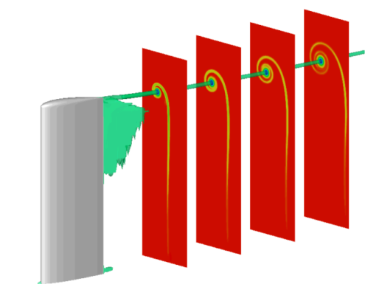
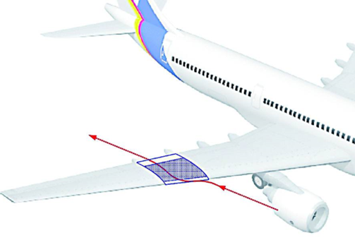
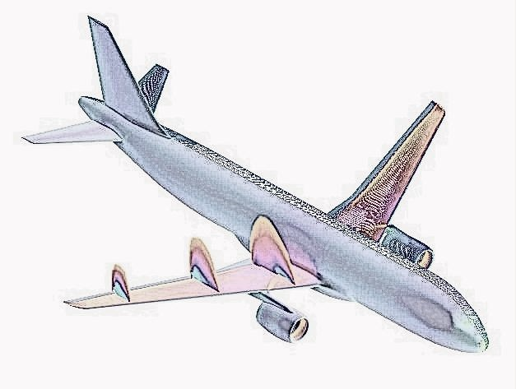
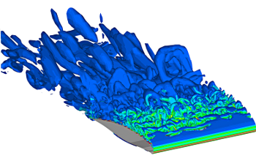
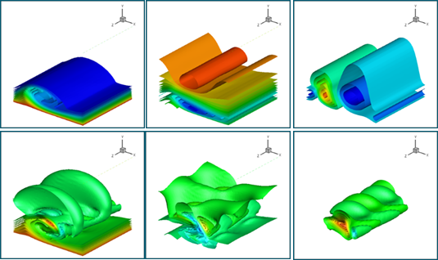
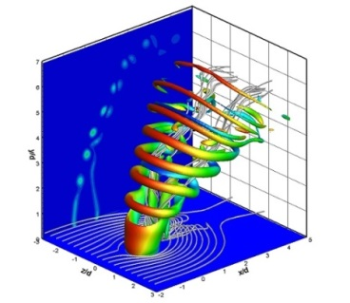
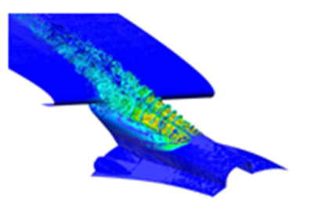
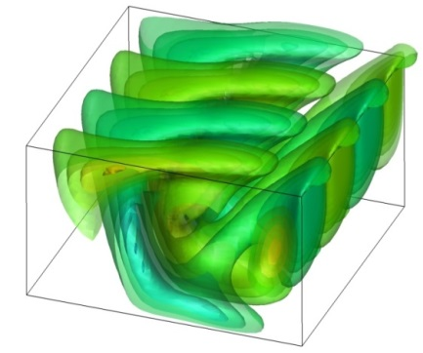
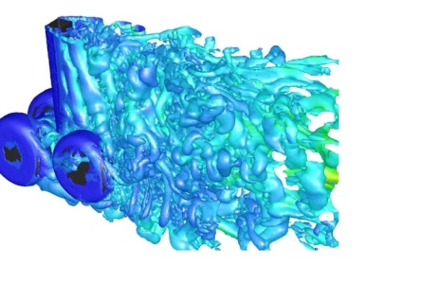

Global Stability
Analysis
Tip vortex
Transition to
turbulence
Crossflow instability
Jets
Detached flows
Cavity flows

Slide 2

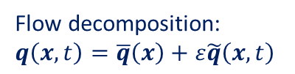
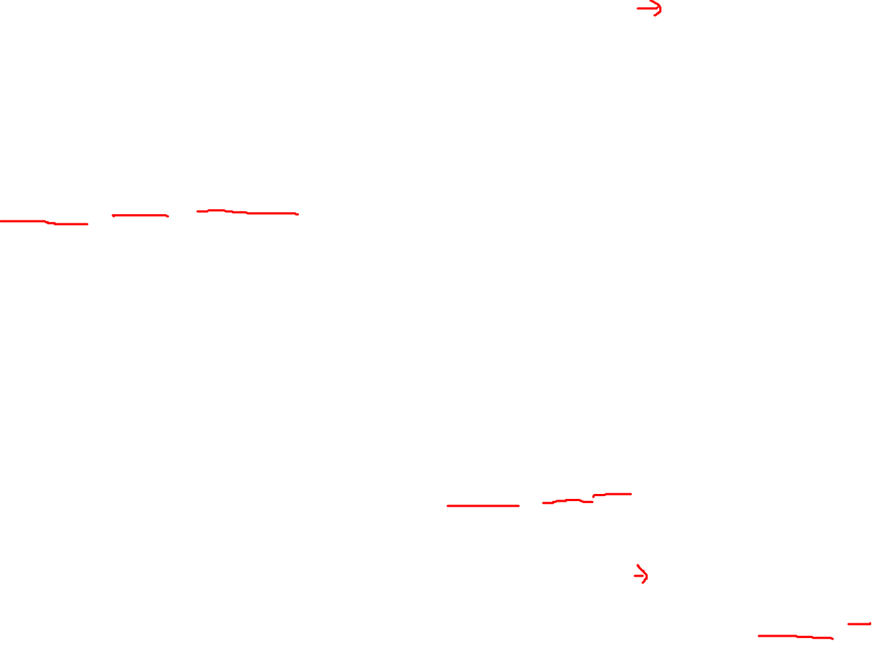

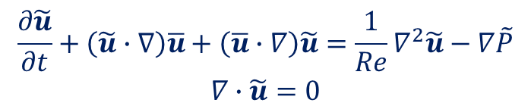
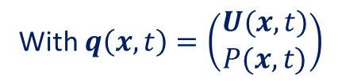
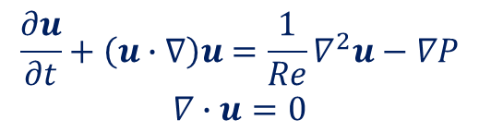

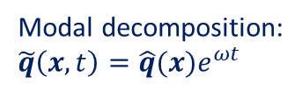
Stability Analysis of Complex Aerodynamic flows
Incompressible Navier-Stokes
Linear Stability Analysis.
$$\begin{matrix}\frac{∂u}{∂t}+\left(u∙∇\right)u=\frac{1}{Re}∇^{2}u−∇P \\ ∇∙u=0\end{matrix}$$
Decomposition of flow variables
$$q\left(x,t\right)=\overline{q}\left(x\right)+ε\tilde{q}\left(x,t\right)$$
Flow decomposition:
$q\left(x,t\right)=\overline{q}\left(x\right)+ε\tilde{q}\left(x,t\right)$
Steady base flow
Linearized equations $𝒪(ε)$
Small Perturbation
$$\begin{matrix}\frac{∂\tilde{u}}{∂t}+\left(\tilde{u}∙∇\right)\overline{u}+\left(\overline{u}∙∇\right)\tilde{u}=\frac{1}{Re}∇^{2}\tilde{u}−∇\tilde{P} \\ ∇∙\tilde{u}=0\end{matrix}$$
With $q\left(x,t\right)=\left(\begin{matrix}U(x,t) \\ P(x,t)\end{matrix}\right)$
Modal decomposition:
$\tilde{q}\left(x,t\right)=\hat{q}(x)e^{ωt}$
Generalized Eigenvalue Problem
$$A\hat{q}\left(x\right)=ωB\hat{q}\left(x\right)$$

Slide 3
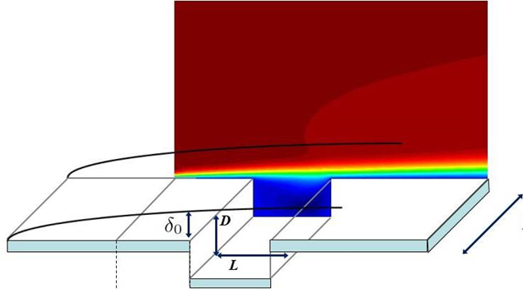


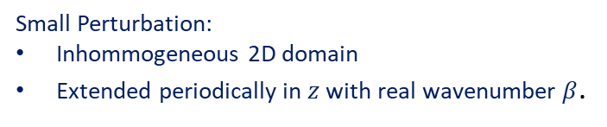
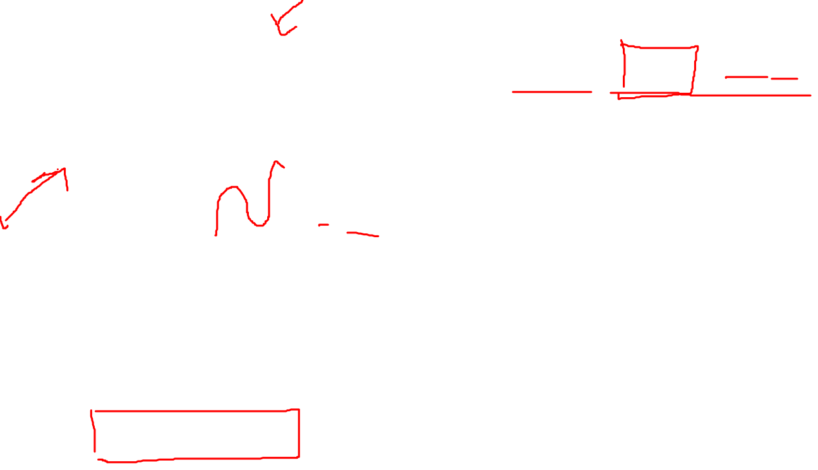
Stability Analysis of Complex Aerodynamic flows
Linear Stability Analysis.
Example: Open cavity problem
Decomposition of flow variables. BiGlobal
$$q\left(x,y,z,t\right)=\overline{q}\left(x,y\right)+ε\hat{q}(x,y)e^{−i(βz−ωt) }$$
2D steady base flow
Small Perturbation:
Inhommogeneous 2D domain
Extended periodically in $z$ with real wavenumber $β$.
$$L_{z}=\frac{2π}{β}$$
Generalized Real non-symmetric Eigenvalue Problem
Linearized Navier Stokes equations
$$A\hat{q}\left(x\right)=ωB\hat{q}\left(x\right)$$

Slide 4
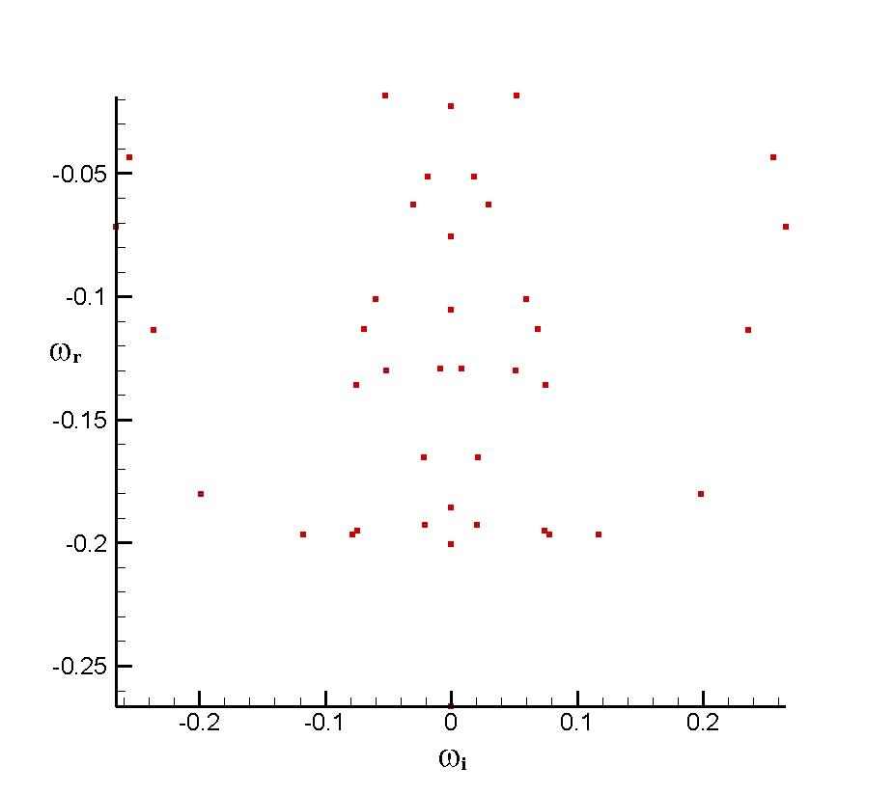
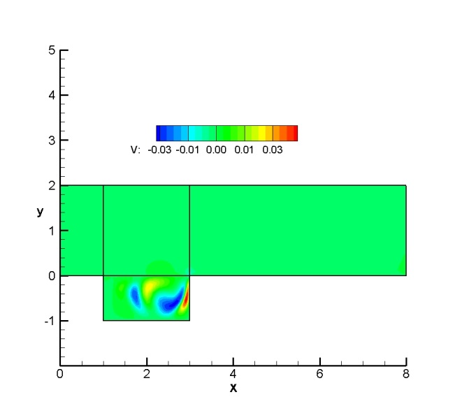
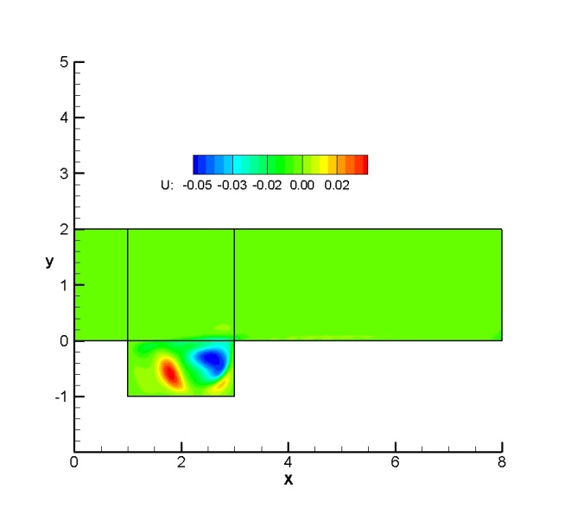
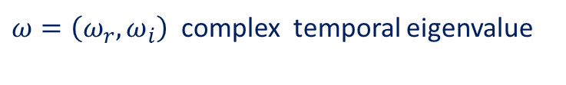



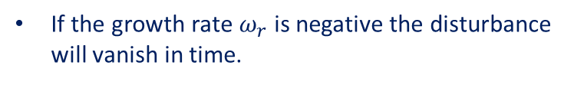
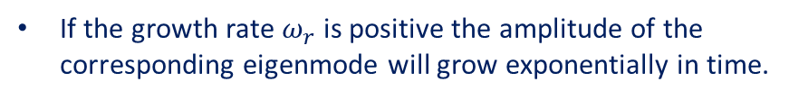

Stability Analysis of Complex Aerodynamic flows
Linear Stability Analysis.
Example: Open cavity problem
Frequency
Amplification/Damping rate
$ω_{r}>0$ unstable mode
$ω_{r}<0$ stable mode
Generalized Real non-symmetric Eigenvalue Problem
$ω=\left(ω_{r},ω_{i}\right)$ complex temporal eigenvalue
$$L_{z}=\frac{2π}{β}$$
$$A\hat{q}\left(x,y\right)=ωB\hat{q}\left(x,y\right)$$
$\hat{q}(x,y)$ complex disturbance eigenvector
Least stable
eigenmodes
If the growth rate $ω_{r}$ is positive the amplitude of the corresponding eigenmode will grow exponentially in time.
If the growth rate $ω_{r}$ is negative the disturbance will vanish in time.

Slide 5
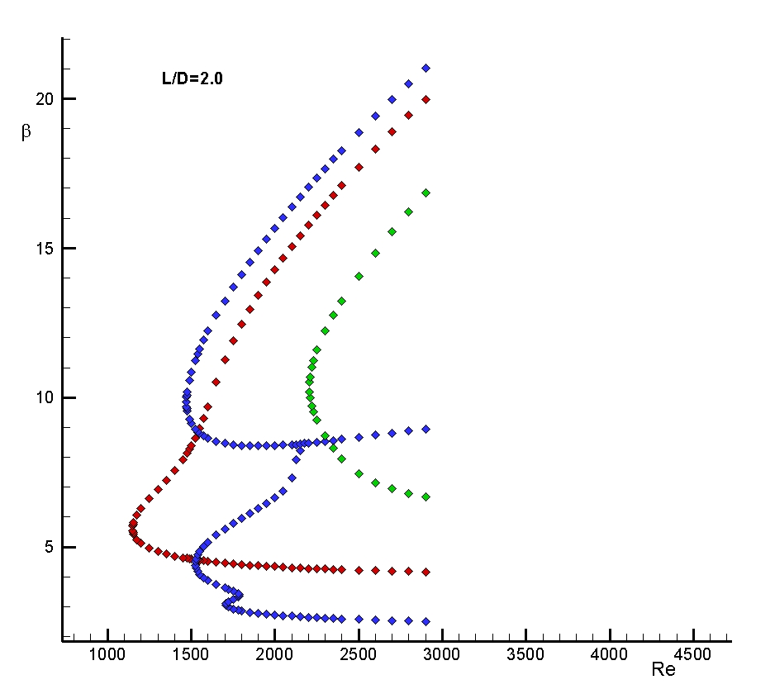
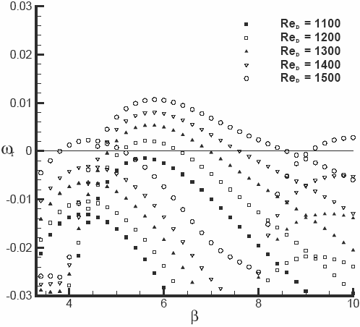

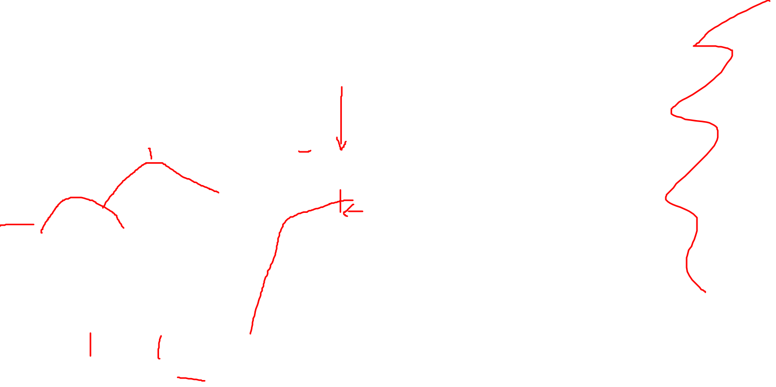
Stability Analysis of Complex Aerodynamic flows
Linear Stability Analysis.
Example: Open cavity problem
Neutral Stability Curves
$$L_{z}=\frac{2π}{β}$$
Re

Slide 6
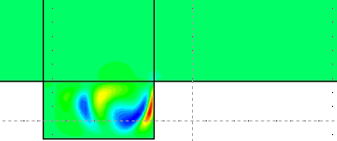
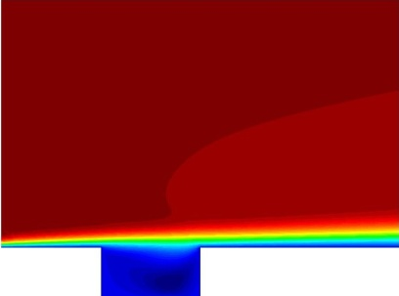
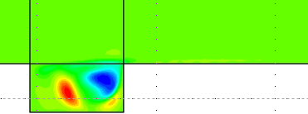
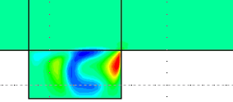

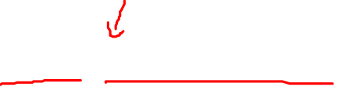
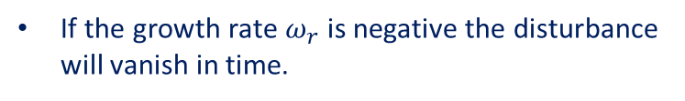
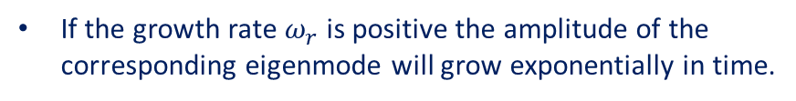
Stability Analysis of Complex Aerodynamic flows
Linear Stability Analysis.
Example: Open cavity problem
Amplification/Damping rate
$ω_{r}>0$ unstable mode
$ω_{r}<0$ stable mode
Generalized Real non-symmetric Eigenvalue Problem
$ω=\left(ω_{r},ω_{i}\right)$ complex temporal eigenvalue
$$A\hat{q}\left(x,y\right)=ωB\hat{q}\left(x,y\right)$$
$\hat{q}(x,y)$ complex disturbance eigenvector
Frequency
Final solution can be reconstructed:
$$q\left(x,t\right)=\overline{q}\left(x\right)+ε\hat{q}(x,y)e^{−i(βz−ωt) }$$
If the growth rate $ω_{r}$ is positive the amplitude of the corresponding eigenmode will grow exponentially in time.
If the growth rate $ω_{r}$ is negative the disturbance will vanish in time.
Final solution –in linear stability analysis- may be seen as a linear combination of the unstable modes.

Slide 7
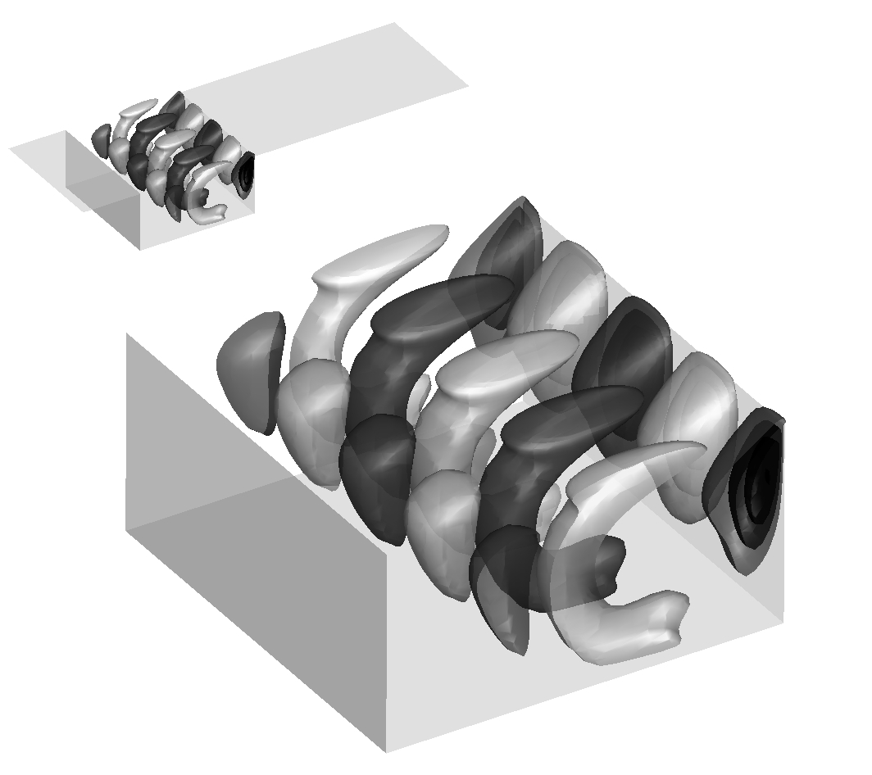
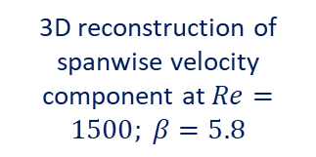

Stability Analysis of Complex Aerodynamic flows
Linear Stability Analysis.
Example: Open cavity problem
Amplification/Damping rate
$ω_{r}>0$ unstable mode
$ω_{r}<0$ stable mode
Generalized Real non-symmetric Eigenvalue Problem
$ω=\left(ω_{r},ω_{i}\right)$ complex temporal eigenvalue
$$A\hat{q}\left(x,y\right)=ωB\hat{q}\left(x,y\right)$$
$\hat{q}(x,y)$ complex disturbance eigenvector
Frequency
Final solution can be reconstructed:
$$q\left(x,t\right)=\overline{q}\left(x\right)+ε\hat{q}(x,y)e^{−i(βz−ωt) }$$
If the growth rate $ω_{r}$ is positive the amplitude of the corresponding eigenmode will grow exponentially in time.
3D reconstruction of spanwise velocity component at $Re=1500; β=5.8$
If the growth rate $ω_{r}$ is negative the disturbance will vanish in time.
Final solution –in linear stability analysis- may be seen as a linear combination of the unstable modes.

Slide 8

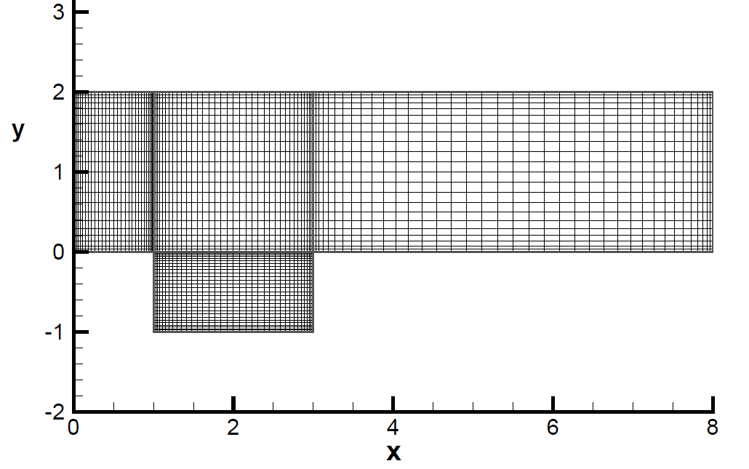
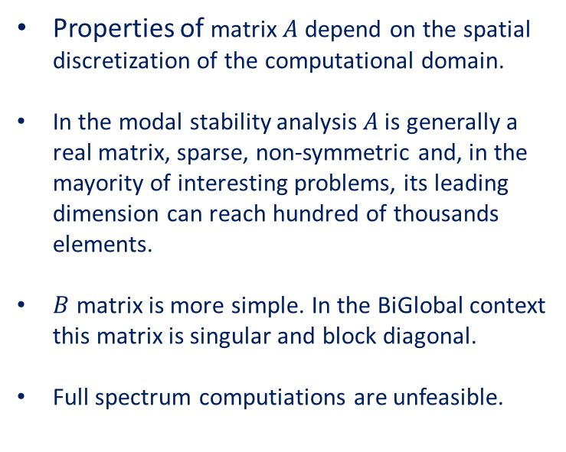
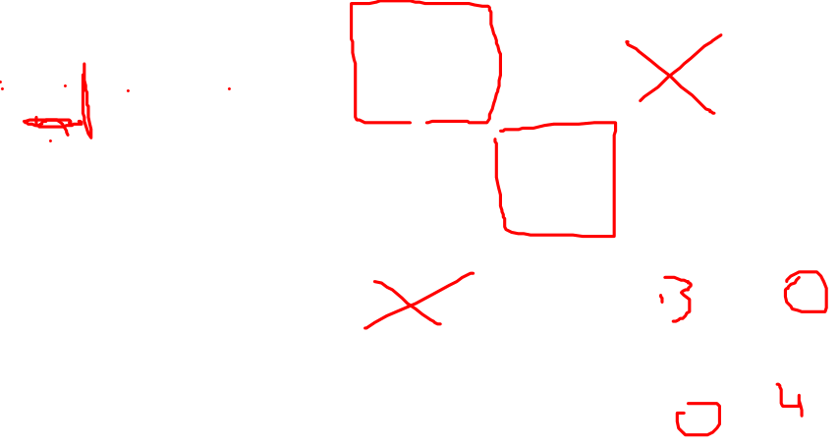
Stability Analysis of Complex Aerodynamic flows
Linear Stability Analysis.
Generalized Eigenvalue Problem:$A\hat{q}\left(x\right)=ωB\hat{q}\left(x\right)$

Slide 9
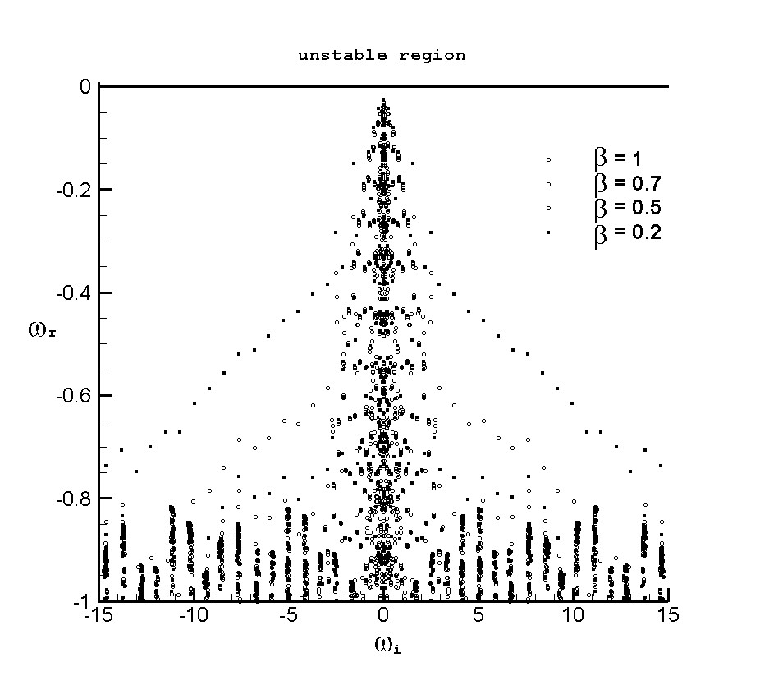
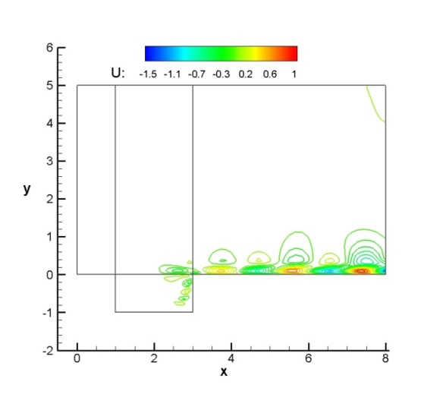
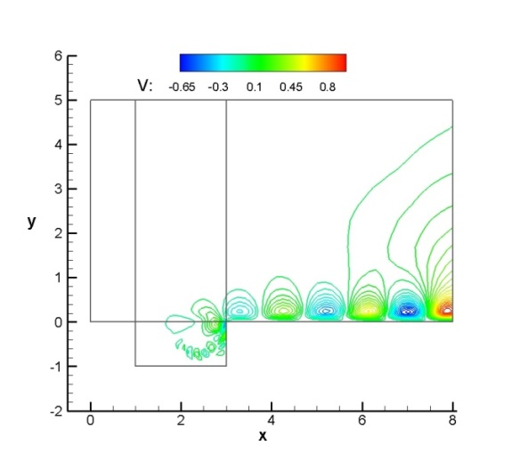

Stability Analysis of Complex Aerodynamic flows
Linear Stability Analysis. Recovered desired part of the spectrum.
$$L_{z}=\frac{2π}{β}$$
Least stable
cavity modes
Open cavity problem
Wake-Like
modes

Slide 10
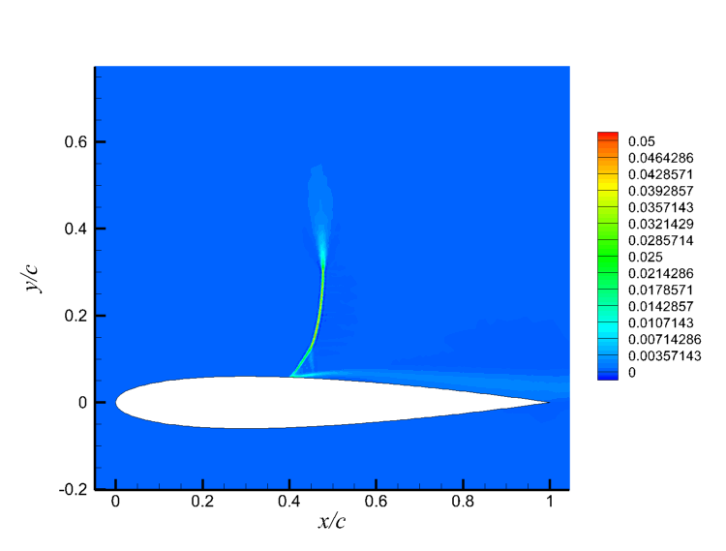
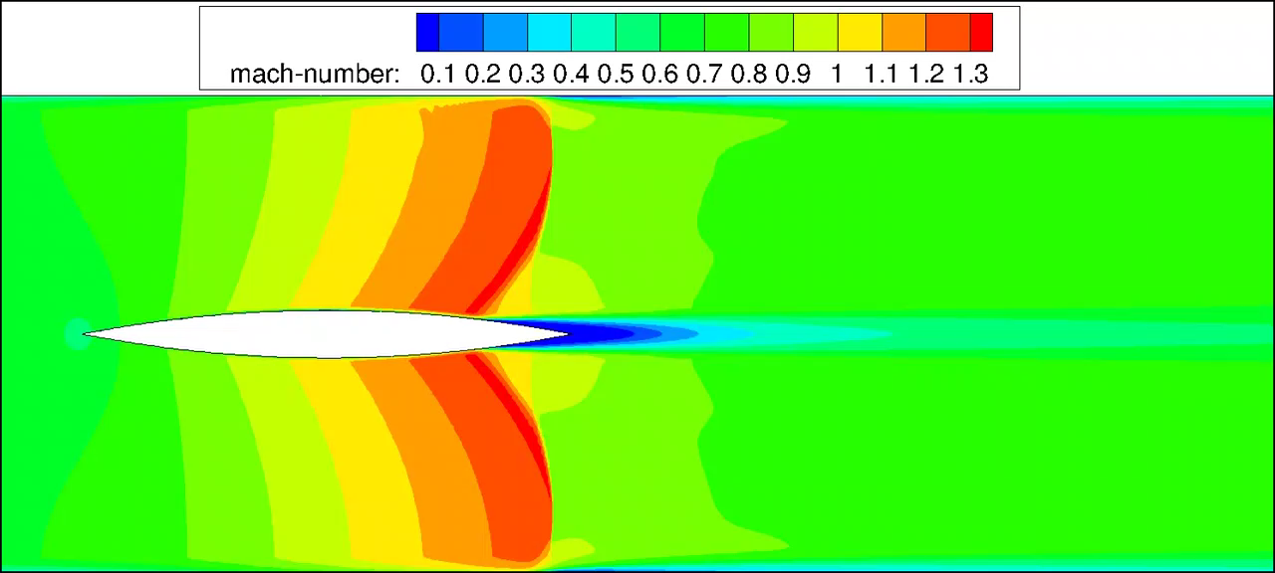
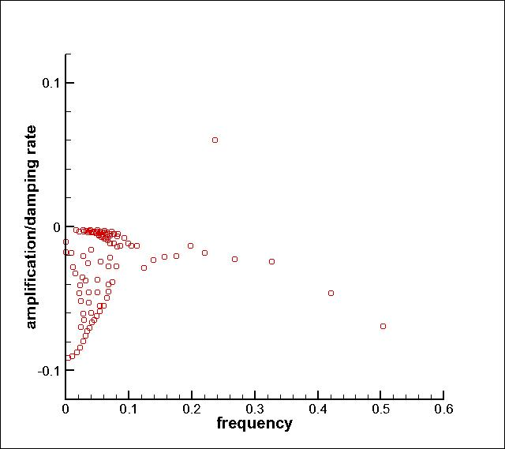
Stability Analysis of Complex Aerodynamic flows
Linear Stability Analysis. Recovered desired part of the spectrum.
Buffet problem: The buffet phenomen is defined as a strong shock boundary layer interaction during the transonic condition on an airfoil.
Eigenvalue associated to the
Buffet phenomenon.
x-velocity component

Slide 11
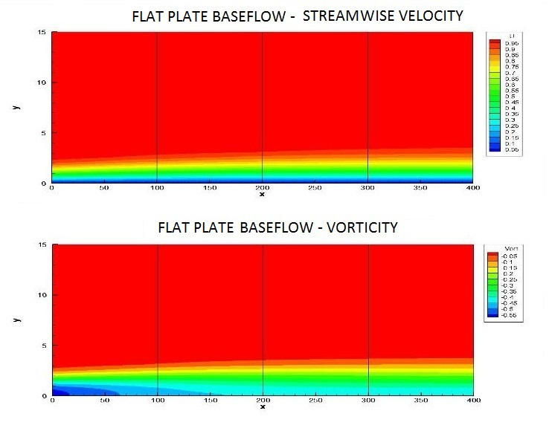
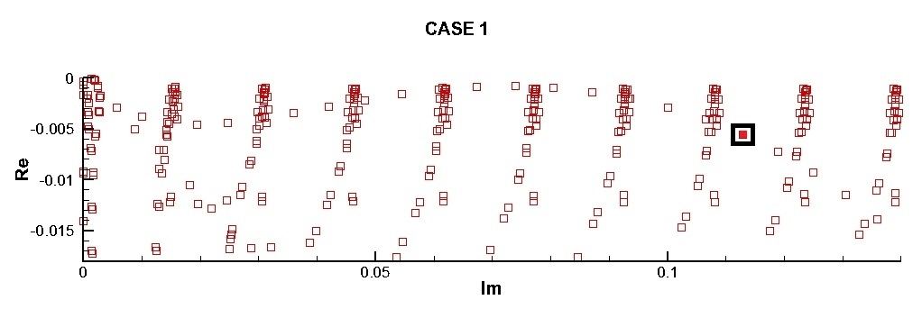
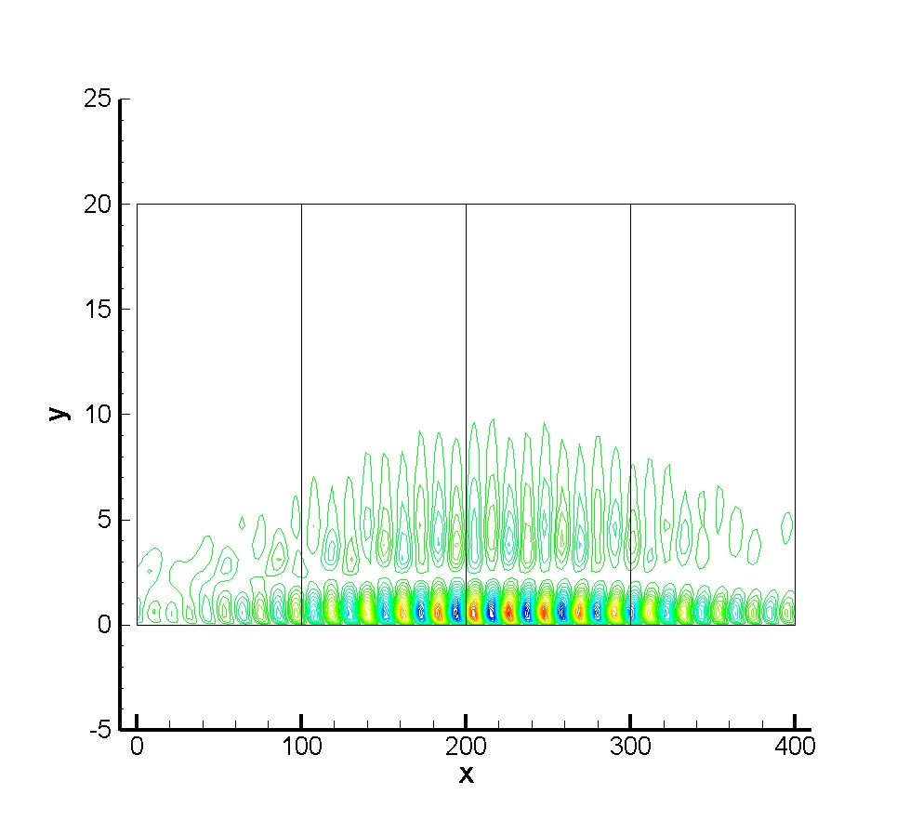
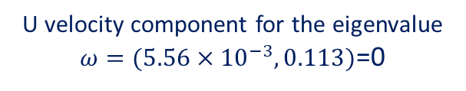


Stability Analysis of Complex Aerodynamic flows
Linear Stability Analysis. Recovered desired part of the spectrum.
U velocity component for the eigenvalue $ω=(5.56×{10}^{−3},0.113)$=0
2D ($β$=0) Flat plate stability problem.

Slide 12





Stability Analysis of Complex Aerodynamic flows
Linear Stability Analysis. Recovered desired part of the spectrum.
High lift problem. $Re={10}^{6};Ma=0.22; AoA=0−30º$

