Slide 1
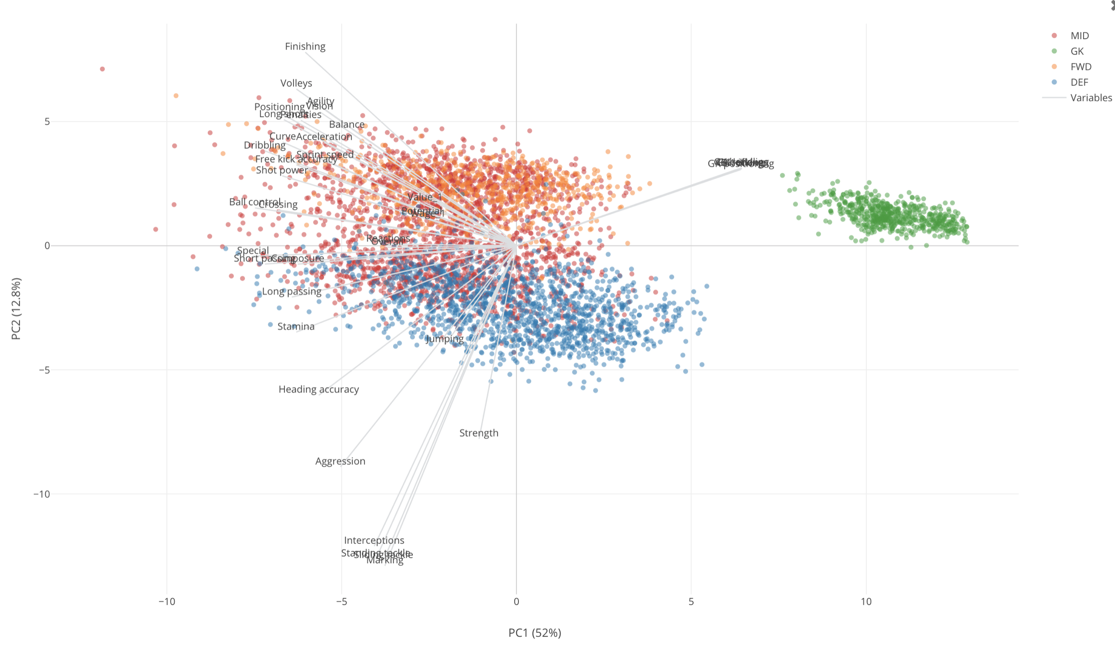
Principal Component Analysis
* Image from Introduction to PCA with FIFA Soccer Data

Slide 2
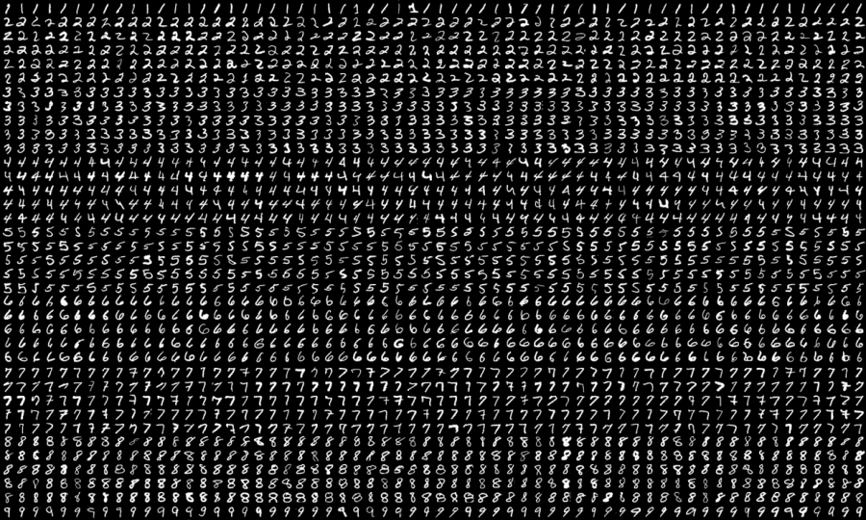
Principal Component Analysis
Handwritten Recognition with Principal Component Analysis
Goal: Speed up machine learning algorithms with dimension reduction
MNIST Data Base http://yann.lecun.com/exdb/mnist/
Widely known database of handwritten digits.
Digits are size-normalized and centered in a fixed-size image.
Training set with 60.000 handwritten digits.
Test set of 10.000 samples.
Grey scale images are stored as a 28x28 vector of pixels.
Used for pattern recognition methods, automatic classifiers, neural nets, convolutional nets…
2

Slide 3
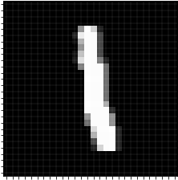
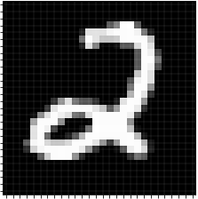
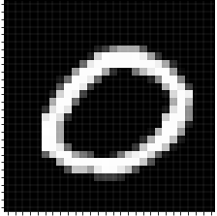
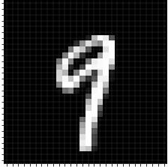

Principal Component Analysis
N= # images in the data set
0
0
0
0
0
0
0
0
0
65
113
255
5
4
67
165
201
198
2
71
99
D= 28x28 pixels
0
0
0
0
0
0
0
0
0
$$X∈𝕄_{D×N}$$
Data matrix

Slide 4
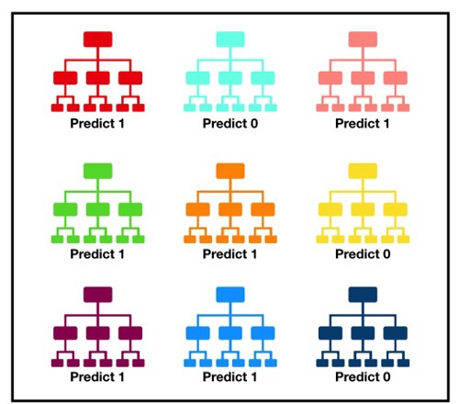
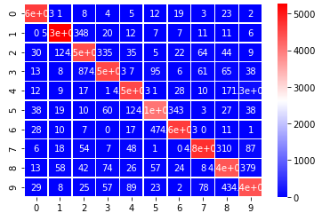
Principal Component Analysis
Random forest classifier will be used to predict which of 10 digits is being written
Prediction is done with the function RandomForestClassifier from sklearn Python library.
Confusion matrix. Number of correct and incorrect predictions for every digit
20% of the original data is included in the train (80% test).
Accuracy 96% for the original dataset
Great performance!!
But…
A random forest is a set of decision trees that operates as an ensemble. The final decision is most voted in the forest-
(From https://towardsdatascience.com/ )
A handwritten ‘5’ can be confused with a ‘6’

Slide 5
Principal Component Analysis
Not every pixel is equally relevant for predicting the handwritting digit.
“Corner” pixels remains black for every digit from 0 to 9.
Maybe the classifier can do as well even when the number of features is reduced.
How can we select the most significant features that capture most of the information about the dataset?
Principal Component Analysis (PCA) is used to reduce the dimensionality of the data.
PCA operates by finding the directions where there is the most of the variance in the data.

Slide 6
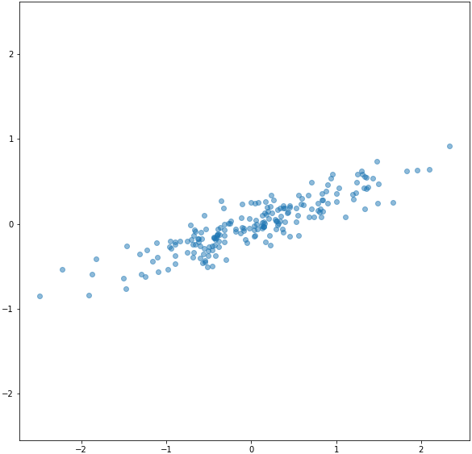

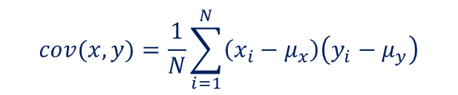





Principal Component Analysis
Given a 2D dataset:
$$\left\{\left(x_{1},y_{1}\right),\left(x_{2},y_{2}\right),…,\left(x_{N},y_{N}\right)\right\}$$
$$μ_{x}=\frac{1}{N}\sum_{i=1}^{N}{{ x}_{i}}; μ_{y}=\frac{1}{N}\sum_{i=1}^{N}{{ y}_{i}}$$
Means:
Variance:
$$δ_{x}^{2}=\sum_{i=1}^{N}{{\left(x_{i}−μ_{x}\right)}^{2}}$$
$$δ_{y}^{2}=\sum_{i=1}^{N}{{\left(y_{i}−μ_{y}\right)}^{2}}$$
$$cov(x,y)=\frac{1}{N}\sum_{i=1}^{N}{\left(x_{i}−μ_{x}\right)\left(y_{i}−μ_{y}\right)}$$
Covariance
$$μ_{x}=0.033 { μ}_{y}=−0.004$$
$δ_{x}^{2}=0.6787$ $δ_{y}^{2}=0.098$
$$cov(x,y)=0.2309$$

Slide 7



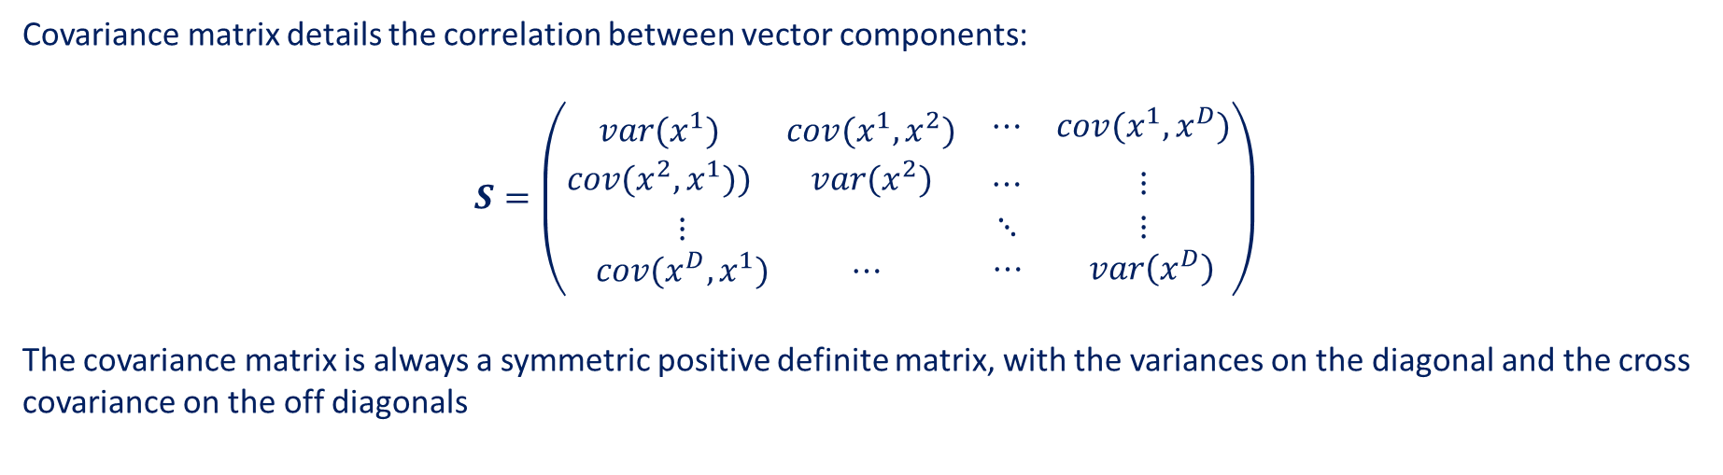

Principal Component Analysis
Given a dataset $X$ consisting in $N$ vectors of dimension $D$:
$$X∈𝕄_{D×N}; X= \left\{x_{1},x_{2},…,x_{N}\right\},{ x}_{j}={\left(x_{j}^{1},x_{j}^{2},…,x_{j}^{D}\right)}^{T}$$
$$μ∈ℝ^{D}=\frac{1}{N}\sum_{j=1}^{N}{{ x}_{j}}$$
The mean is a vector in $ℝ^{D}$ and can be easily obtained,
And so the covariance matrix, defined as the $D×D$ matrix
$$S∈𝕄_{D×D}=\frac{1}{N}\sum_{j=1}^{N}{\left({ x}_{j}−μ\right)}{\left({ x}_{j}−μ\right)}^{T}$$
Covariance matrix details the correlation between vector components:
$$S=\left(\begin{matrix}\begin{matrix}var(x^{1}) & cov(x^{1},x^{2}) \\ cov(x^{2},x^{1})) & var(x^{2})\end{matrix} & \begin{matrix}⋯ & cov(x^{1},x^{D}) \\ ⋯ & {}_{}^{}{}⋮{}_{}^{}{}\end{matrix} \\ \begin{matrix}⋮ & \\ cov(x^{D},x^{1}) & ⋯ \end{matrix} & \begin{matrix}⋱ & ⋮ \\ ⋯ & var\left(x^{D}\right) \end{matrix}\end{matrix}\right)$$
The covariance matrix is always a symmetric positive definite matrix, with the variances on the diagonal and the cross covariance on the off diagonals

Slide 8
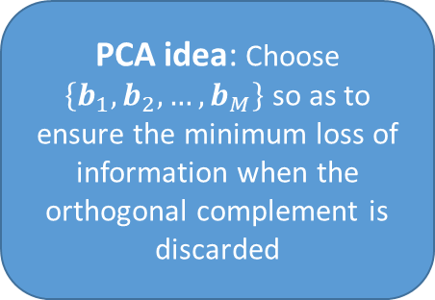
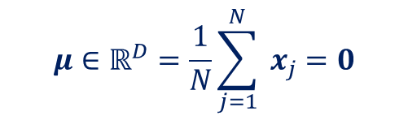

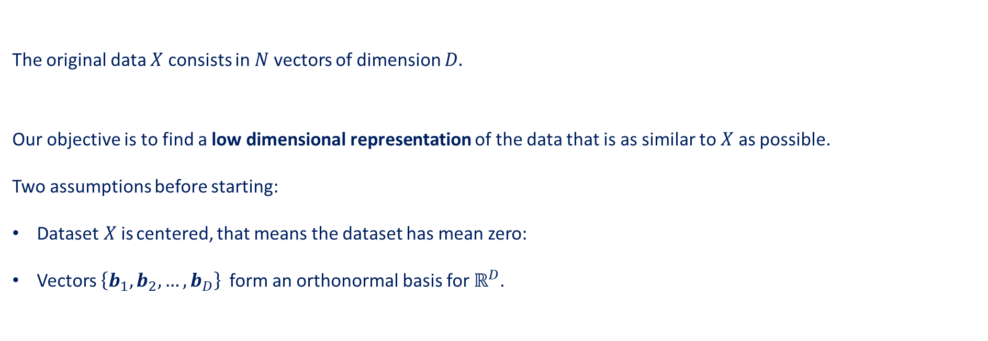





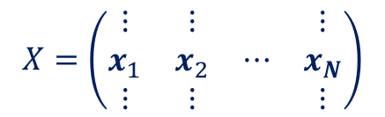
Principal Component Analysis
$$N$$
Deriving PCA
The original data $X$ consists in $N$ vectors of dimension $D.$
Our objective is to find a low dimensional representation of the data that is as similar to $X$ as possible.
Two assumptions before starting:
Dataset$X$is centered, that means the dataset has mean zero:
Vectors $\left\{b_{1},b_{2},…,b_{D}\right\}$ form an orthonormal basis for $ℝ^{D}$.
$$X=\left(\begin{matrix}\begin{matrix}\begin{matrix}⋮ \\ x_{1} \\ ⋮\end{matrix} & \begin{matrix}⋮ \\ x_{2} \\ ⋮\end{matrix}\end{matrix} & \begin{matrix}⋯ & \begin{matrix}⋮ \\ x_{N} \\ ⋮\end{matrix}\end{matrix}\end{matrix}\right)$$
$$D$$
$$μ∈ℝ^{D}=\frac{1}{N}\sum_{j=1}^{N}{{ x}_{j}}=0$$
$${ x}_{j} =\sum_{i=1}^{D}{{β_{ji} b}_{i}}$$
$$β_{ji}={b_{i}}^{T}{ x}_{j}$$
In that basis every sample can be expressed as a linear combination: with
PCA idea: Choose $\left\{b_{1},b_{2},…,b_{M}\right\}$ so as to ensure the minimum loss of information when the orthogonal complement is discarded
$${ x}_{j}= \sum_{i=1}^{M}{{β_{ji} b}_{i}} + \sum_{i=M+1}^{D}{{β_{ji} b}_{i}}$$
Previous sum can be split into two sums:
$M$-dimensional
Principal subspace:
Orthogonal complement

Slide 9
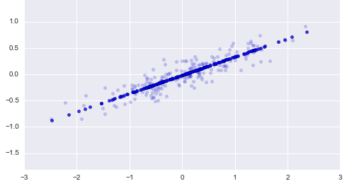





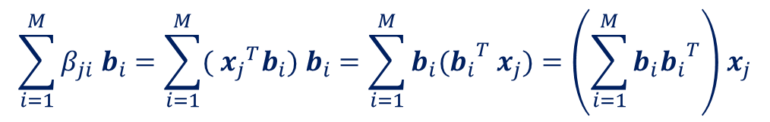


Principal Component Analysis
Previous sum can be split into two sums:
$${ x}_{j}= \sum_{i=1}^{M}{{β_{ji} b}_{i}} + \sum_{i=M+1}^{D}{{β_{ji} b}_{i}}$$
Proyection matrix
$$\sum_{i=1}^{M}{{β_{ji} b}_{i}}=\sum_{i=1}^{M}{{({{ x}_{j}}^{T}b_{i}) b}_{i}}=\sum_{i=1}^{M}{b_{i}({b_{i}}^{T}{ x}_{j})}=\left(\sum_{i=1}^{M}{b_{i}{b_{i}}^{T}}\right){ x}_{j}$$
$${ \tilde{x}}_{j} =$$
$({{ x}_{j}}^{T}b_{i})$ scalar
In matrix form it can be written as:
$$B^{T}X ≡$$
Coordinates of $X$in the Principal Subspace. Also called Code Coordinates
$$\tilde{X}=BB^{T}X$$
$$BB^{T}≡$$
Projection Matrix from original space to Principal Component Subspace
with $B=\left(\begin{matrix}\begin{matrix}\begin{matrix}⋮ \\ b_{1} \\ ⋮\end{matrix} & \begin{matrix}⋮ \\ b_{2} \\ ⋮\end{matrix}\end{matrix} & \begin{matrix}⋯ & \begin{matrix}⋮ \\ b_{M} \\ ⋮\end{matrix}\end{matrix}\end{matrix}\right)$
In light blue original 2D data.
In dark blue projected data in a 1D subspace

Slide 10
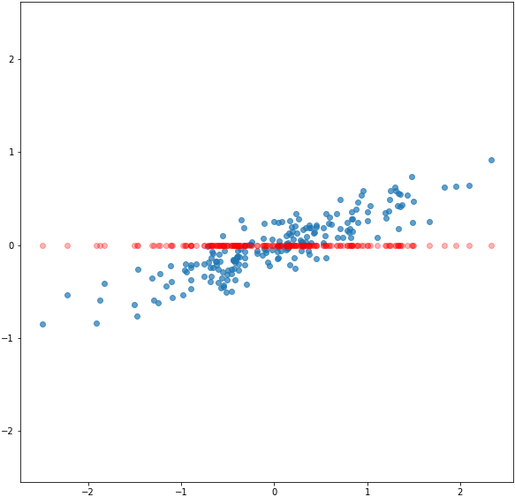
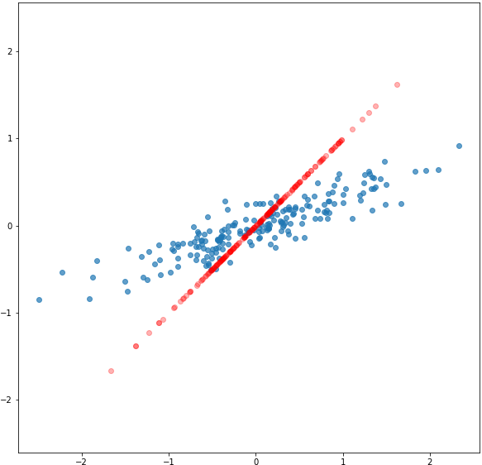
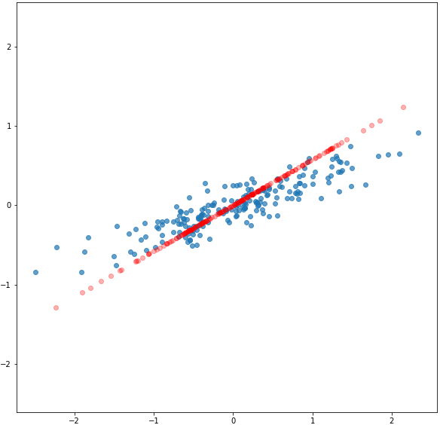



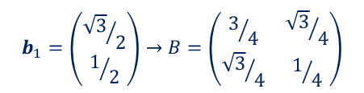
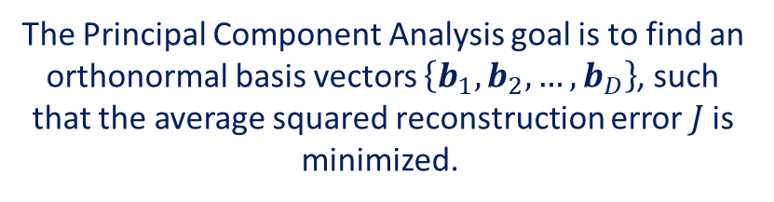

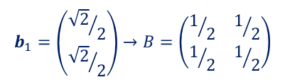
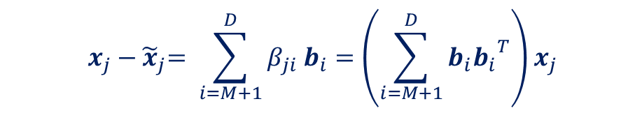

Principal Component Analysis
The reconstruction error for a particular data is defined as follows:
$$b_{1}=\left(\begin{matrix}1 \\ 0\end{matrix}\right)→B=\left(\begin{matrix}1 & 0 \\ 0 & 0\end{matrix}\right)$$
$${ x}_{j} −{ \tilde{x}}_{j}= \sum_{i=M+1}^{D}{{β_{ji} b}_{i}}=\left(\sum_{i=M+1}^{D}{b_{i}{b_{i}}^{T}}\right){ x}_{j}$$
$$J=0.24$$
The Averaged Reconstruction Error function - Loss function
$$J=\frac{1}{N}\sum_{j=1}^{N}{{\left\|{ x}_{j}−{ \tilde{x}}_{j}\right\|}^{2}}$$
$$b_{1}=\left(\begin{matrix}{\sqrt{2}}/2 \\ {\sqrt{2}}/2\end{matrix}\right)→B=\left(\begin{matrix}1/2 & 1/2 \\ 1/2 & 1/2\end{matrix}\right)$$
$$J=0.31$$
The Principal Component Analysis goal is to find an orthonormal basis vectors $\left\{b_{1},b_{2},…,b_{D}\right\}$, such that the average squared reconstruction error $J$ is minimized.
$$b_{1}=\left(\begin{matrix}{\sqrt{3}}/2 \\ 1/2\end{matrix}\right)→B=\left(\begin{matrix}3/4 & {\sqrt{3}}/4 \\ {\sqrt{3}}/4 & 1/4\end{matrix}\right)$$
$$J=0.16$$

Slide 11
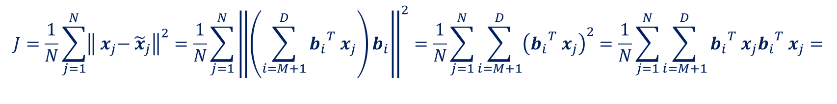

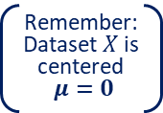

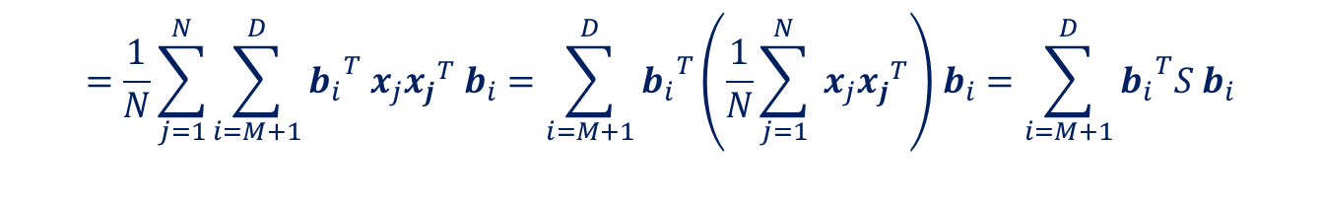
Principal Component Analysis
Rewritting the loss function
Orthonormal Basis
$$J=\frac{1}{N}\sum_{j=1}^{N}{{\left\|{ x}_{j}−{ \tilde{x}}_{j}\right\|}^{2}}=\frac{1}{N}\sum_{j=1}^{N}{{\left\|\left(\sum_{i=M+1}^{D}{{b_{i}}^{T}{ x}_{j}}\right)b_{i}\right\|}^{2}}=\frac{1}{N}\sum_{j=1}^{N}{\sum_{i=M+1}^{D}{{\left({b_{i}}^{T}{ x}_{j}\right)}^{2}}}=\frac{1}{N}\sum_{j=1}^{N}{\sum_{i=M+1}^{D}{{b_{i}}^{T}{ x}_{j}{b_{i}}^{T}{ x}_{j}}}=$$
$$=\frac{1}{N}\sum_{j=1}^{N}{\sum_{i=M+1}^{D}{{b_{i}}^{T}{ x}_{j}{x_{j}}^{T}{ b}_{i}}}=\sum_{i=M+1}^{D}{{b_{i}}^{T}\left(\frac{1}{N}\sum_{j=1}^{N}{{ x}_{j}{x_{j}}^{T}}\right){ b}_{i}}=\sum_{i=M+1}^{D}{{b_{i}}^{T}S{ b}_{i}}$$
Rearranging Summation
Data covariance matrix: $S$
Remember: Dataset$X$is centered
$μ=0$
$$J=\sum_{i=M+1}^{D}{{b_{i}}^{T}S{ b}_{i}}$$
Objetive: Minimize being $S$ a symmetric positive definite matrix

Slide 12

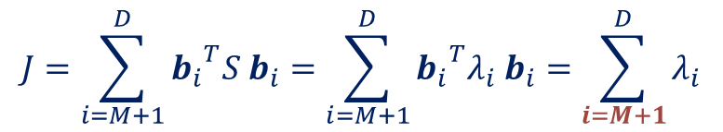
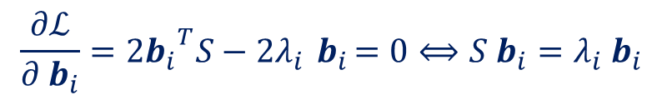
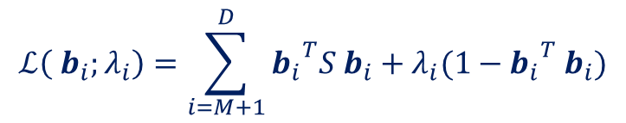
Principal Component Analysis
$$J=\sum_{i=M+1}^{D}{{b_{i}}^{T}S{ b}_{i}}$$
Objetive: Minimize being $S$ a symmetric positive definite matrix subjected to the constraint: ${b_{i}}^{T}{ b}_{j}=δ_{ij}$
$$ℒ\left({ b}_{i};λ_{i}\right)=\sum_{i=M+1}^{D}{{b_{i}}^{T}S{ b}_{i}}+λ_{i}(1−{b_{i}}^{T}{ b}_{i})$$
Lagrangian function:
The critical points verify:
$$\frac{∂ℒ}{∂{ b}_{i}}=2{b_{i}}^{T}S−2λ_{i}{ b}_{i}=0⟺S{ b}_{i}=λ_{i}{ b}_{i}$$
EigenValue Problem for the data covariance matrix
So the loss function is given by the sum of the corresponding eigenvalues:
The average squared reconstruction error is minimized if we choose the basis vectors that spanned the ignored subspace to be the eigenvectors of the data covariance matrix that belong to the smallest eigenvalues.
The eigenvector belonging to the largest eigenvalue points in the direction of the data with the largest variance, and, the variance in that direction is given by the corresponding eigenvalue.
$$J=\sum_{i=M+1}^{D}{{b_{i}}^{T}S{ b}_{i}}=\sum_{i=M+1}^{D}{{b_{i}}^{T}λ_{i}{ b}_{i}}=\sum_{i=M+1}^{D}{λ_{i}}$$

Slide 13
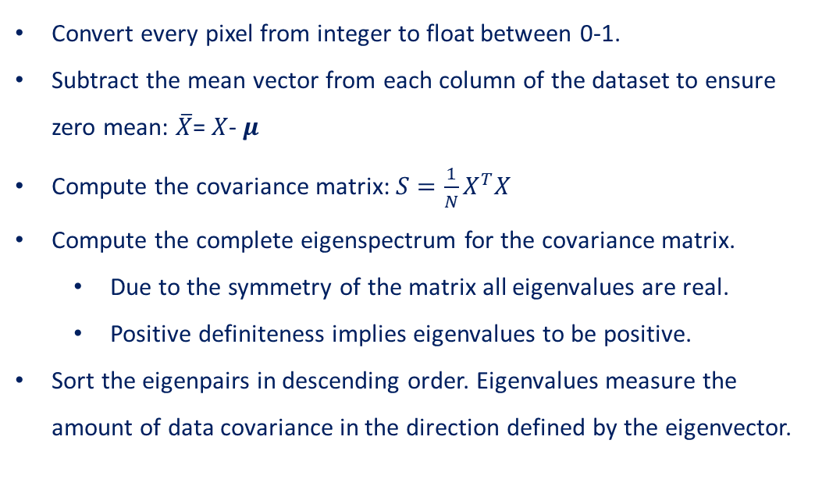

Principal Component Analysis
Back to the Handwritten Digit Classification in the MNIST dataset:
N= # images in the data set
Convert every pixel from integer to float between 0-1.
Subtract the mean vector from each column of the dataset to ensure zero mean: $\overline{X}$= $X$- $μ$
Compute the covariance matrix: $S=\frac{1}{N}X^{T}X$
Compute the complete eigenspectrum for the covariance matrix.
Due to the symmetry of the matrix all eigenvalues are real.
Positive definiteness implies eigenvalues to be positive.
Sort the eigenpairs in descending order. Eigenvalues measure the amount of data covariance in the direction defined by the eigenvector.
0
0
0
0
0
0
0
0
0
65
113
255
5
4
67
165
201
198
2
71
99
D= 28x28 pixels
0
0
0
0
0
0
0
0
0
% Variance Explained
1st Eigenvalue | 9.7%
2nd Eigenvalue | 7%
3rd Eigenvalue | 6.2%
4th Eigenvalue | 5.4%
$$X∈𝕄_{D×N}$$
Data matrix

Slide 14
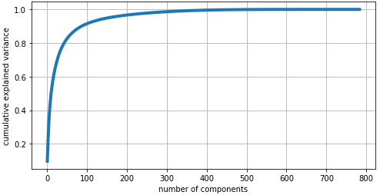

Principal Component Analysis
Back to the Handwritten Digit Classification in the MNIST dataset:
Obtained the proportion of variance explained depending on the dimension of the principal subspace.
90% Variance retained.
$$f\left(k\right)=\frac{\sum_{i=1}^{k}{λ_{i}}}{\sum_{i=1}^{D}{λ_{i}}}$$
50% Variance retained.
30% Variance retained.
86 Eigenvectors
10 Eigenvectors
4 Eigenvectors

Slide 15
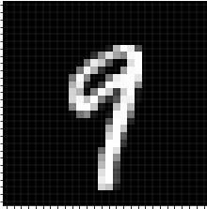
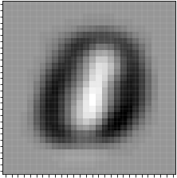
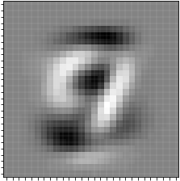
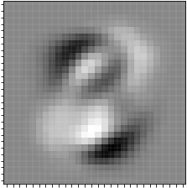
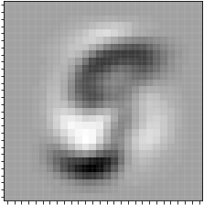
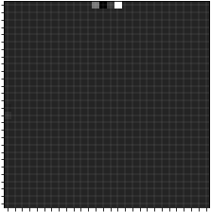
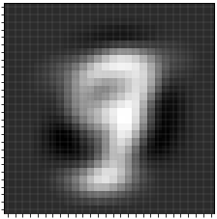
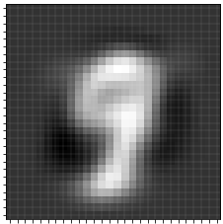
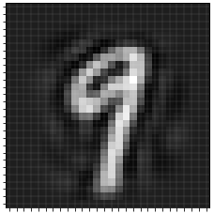



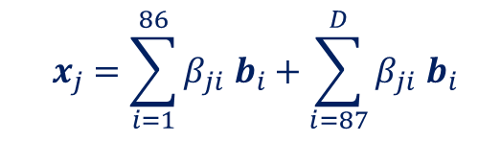


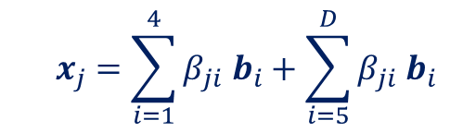
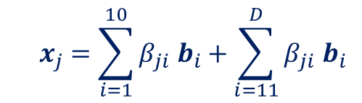

Principal Component Analysis
Back to the Handwritten Digit Classification in the MNIST dataset:
Project original “digits” onto the Principal Components Subspace: $\tilde{X}=BB^{T}X$
1st Eigenvector
2nd Eigenvector
3rd Eigenvector
$$=β_{1}$$
$$+β_{2}$$
$$+β_{3}$$
$$+β_{4}$$
$$+… +β_{D}$$
$${ x}_{j} =\sum_{i=1}^{4}{{β_{ji} b}_{i}}+\sum_{i=5}^{D}{{β_{ji} b}_{i}}$$
$${ x}_{j} =\sum_{i=1}^{10}{{β_{ji} b}_{i}}+\sum_{i=11}^{D}{{β_{ji} b}_{i}}$$
$${ x}_{j} =\sum_{i=1}^{86}{{β_{ji} b}_{i}}+\sum_{i=87}^{D}{{β_{ji} b}_{i}}$$

Slide 16
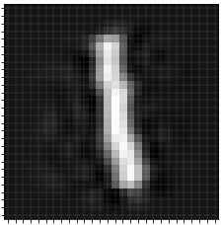
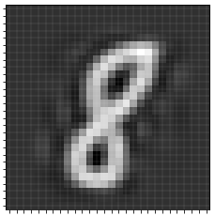
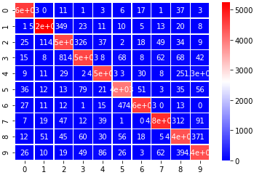






Principal Component Analysis
Reconstructed Images
Confusion matrices of the Random Forest Classiffier
90% Variance retained.
86 Eigenvectors / Principal Components
95% Accuracy
50% Variance retained.
10 Eigenvectors / Principal Components
90% Accuracy
30% Variance retained.
4 Eigenvectors / Principal Components
64% Accuracy

