Slide 1
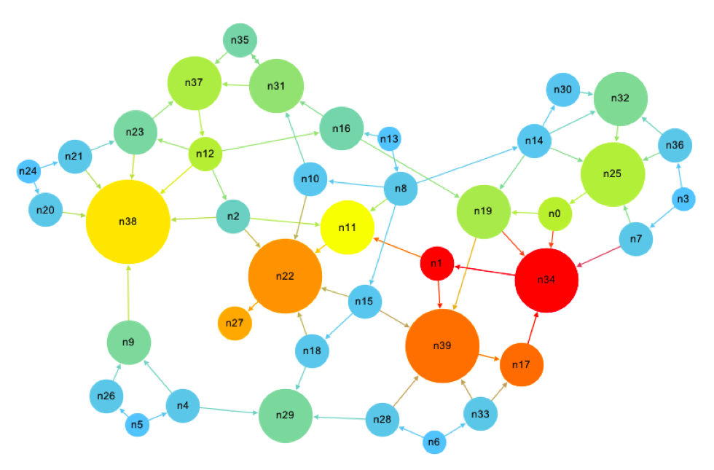

PageRank algorithm
* Image from Inside the trash can

Slide 2

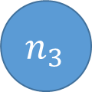
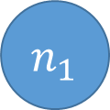

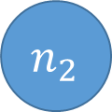

PageRank algorithm
Objetive: Rank web pages based on their importance
Model: World Wide Web is modelled as a directed graph, where nodes are pages and arcs are hyperlinks.
Seems reasonable to consider that a web page is more important as it has more incoming links from important pages.
This definition is somewhat circular: To define the importance of a web page we need to know in advance the importance of the pages that conform the web
$$n_{1}$$
$$n_{2}$$
$$n_{3}$$
$$n_{4}$$
$$n_{5}$$
$$n_{6}$$
2

Slide 3


PageRank algorithm
Idea -Random Walker- Imagine a random web surfer who starts at a web page and keeps clicking on succesive links with equal probability.
$$n_{1}$$
$$n_{2}$$
$$n_{3}$$
$$n_{4}$$
$$n_{5}$$
$$n_{6}$$
3

Slide 4

PageRank algorithm
Idea -Random Walker- Imagine a random web surfer who starts at a web page and keeps clicking on succesive links with equal probability.
$$n_{1}$$
Place a great number of web surfers in every page in the web. Those walkers will spread out equally through the outlinks in the next step. In this procedure each page distributes its importance while receiving the importance of pages pointing to it.
$$n_{2}$$
$$n_{3}$$
$$n_{4}$$
$$n_{5}$$
$$n_{6}$$
4

Slide 5
PageRank algorithm
Idea -Random Walker- Imagine a random web surfer who starts at a web page and keeps clicking on succesive links with equal probability.
$$n_{1}$$
Place a great number of web surfers in every page in the web. Those walkers will spread out equally through the outlinks in the next step. In this procedure each page distributes its importance while receiving the importance of pages pointing to it.
$$n_{2}$$
$$n_{3}$$
$$n_{4}$$
$$n_{5}$$
$$n_{6}$$
5

Slide 6
PageRank algorithm
Idea -Random Walker- Imagine a random web surfer who starts at a web page and keeps clicking on succesive links with equal probability.
$$n_{1}$$
Place a great number of web surfers in every page in the web. Those walkers will spread out equally through the outlinks in the next step. In this procedure each page distributes its importance while receiving the importance of pages pointing to it.
$$n_{2}$$
$$n_{3}$$
$$n_{4}$$
$$n_{5}$$
There are some important questions that surely arise:
Will this proccess finish in a stationary state?
What is the effect of a page with no outlinks?
$$n_{6}$$
6

Slide 7
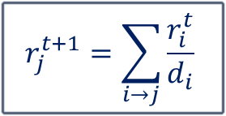
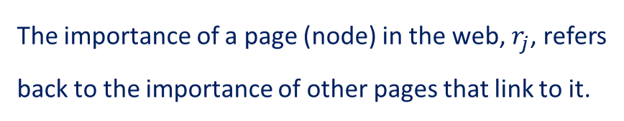
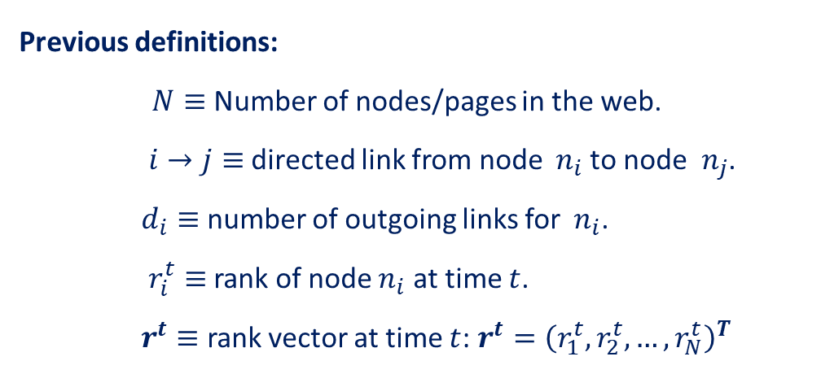

PageRank algorithm
Before answering those questions let’s build a mathematical framework for the initial toy model.
Previous definitions:
$N≡$ Number of nodes/pages in the web.
$i→j≡$ directed link from node ${ n}_{i}$to node ${ n}_{j}$.
$d_{i}≡$ number of outgoing links for${ n}_{i}$.
$r_{i}^{t}≡$ rank of node $n_{i}$ at time $t$.
$r^{t}≡$ rank vector at time $t$: $r^{t}={\left(r_{1}^{t},r_{2}^{t},…,r_{N}^{t}\right)}^{T}$
$$n_{1}$$
$$n_{2}$$
$$n_{3}$$
$$n_{4}$$
$$n_{5}$$
The importance of a page (node) in the web, $r_{j}$, refers back to the importance of other pages that link to it.
$$r_{j}^{t+1}=\sum_{i→j}{\frac{r_{i}^{t}}{d_{i}}}$$
$$n_{6}$$
7

Slide 8
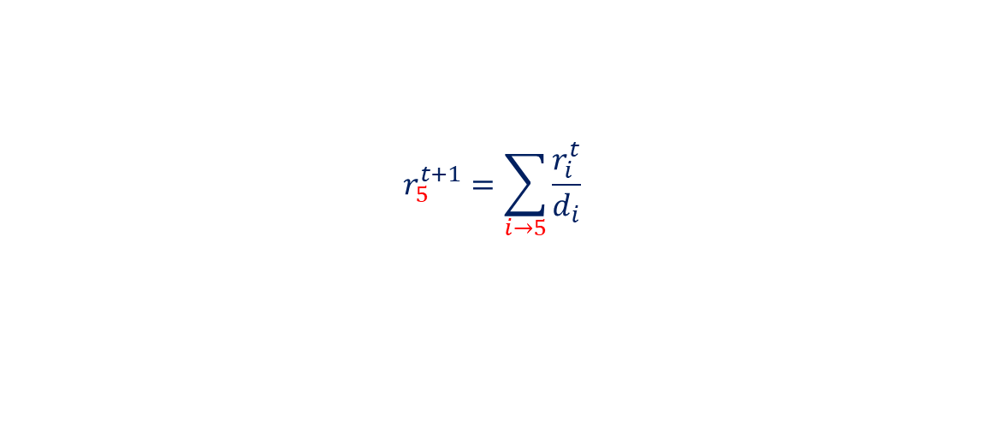
PageRank algorithm
Let’s inspect the formula for node $n_{5}$
$$r_{5}^{t+1}=\sum_{i→5}{\frac{r_{i}^{t}}{d_{i}}}$$
$$n_{1}$$
$$n_{2}$$
$$n_{3}$$
$$n_{4}$$
$$n_{5}$$
$$n_{6}$$
8

Slide 9
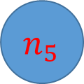
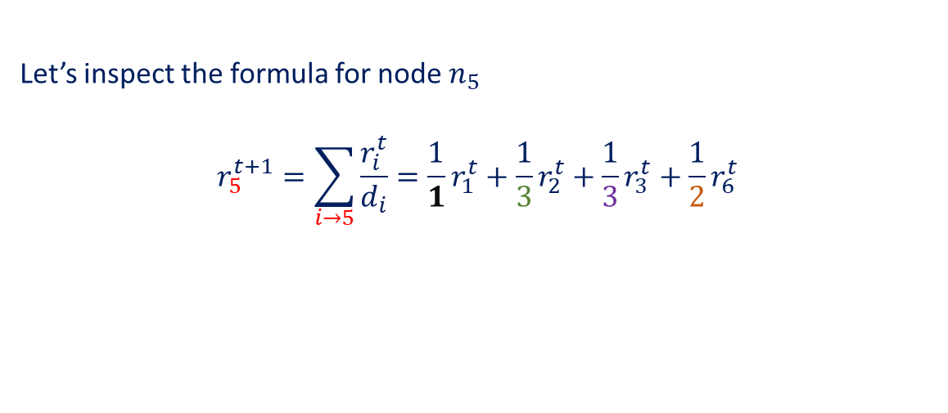
PageRank algorithm
Let’s inspect the formula for node $n_{5}$
$$r_{5}^{t+1}=\sum_{i→5}{\frac{r_{i}^{t}}{d_{i}}}=\frac{1}{1}r_{1}^{t}+\frac{1}{3}r_{2}^{t}+\frac{1}{3}r_{3}^{t}+\frac{1}{2}r_{6}^{t}$$
$$n_{1}$$
$$n_{2}$$
$$n_{3}$$
$$n_{4}$$
$$n_{5}$$
$$n_{6}$$
9

Slide 10


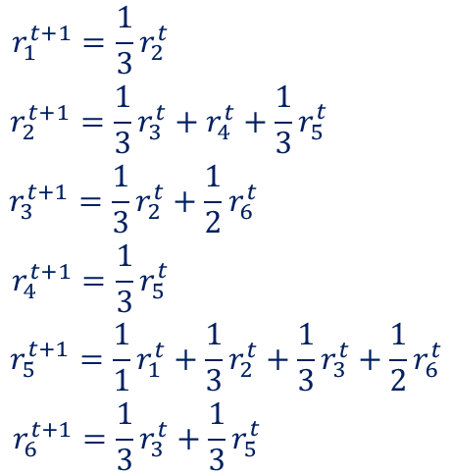
PageRank algorithm
Let’s inspect the formula for node $n_{5}$
$$r_{5}^{t+1}=\sum_{i→5}{\frac{r_{i}^{t}}{d_{i}}}=\frac{1}{1}r_{1}^{t}+\frac{1}{3}r_{2}^{t}+\frac{1}{3}r_{3}^{t}+\frac{1}{2}r_{6}^{t}$$
$$n_{1}$$
Extending the formula for each node:
$$\begin{matrix}\begin{matrix}r_{1}^{t+1}=\frac{1}{3}r_{2}^{t} \\ r_{2}^{t+1}=\frac{1}{3}r_{3}^{t}+r_{4}^{t}+\frac{1}{3}r_{5}^{t} \\ r_{3}^{t+1}=\frac{1}{3}r_{2}^{t}+\frac{1}{2}r_{6}^{t} \end{matrix} \\ \begin{matrix}r_{4}^{t+1}=\frac{1}{3}r_{5}^{t} \\ r_{5}^{t+1}=\frac{1}{1}r_{1}^{t}+\frac{1}{3}r_{2}^{t}+\frac{1}{3}r_{3}^{t}+\frac{1}{2}r_{6}^{t} \\ r_{6}^{t+1}=\frac{1}{3}r_{3}^{t}+\frac{1}{3}r_{5}^{t} \end{matrix}\end{matrix}$$
$$n_{2}$$
$$n_{3}$$
$$n_{4}$$
$$n_{5}$$
$${⟺r}^{t+1}=Ar^{t}$$
Transition Matrix
$$n_{6}$$
10

Slide 11

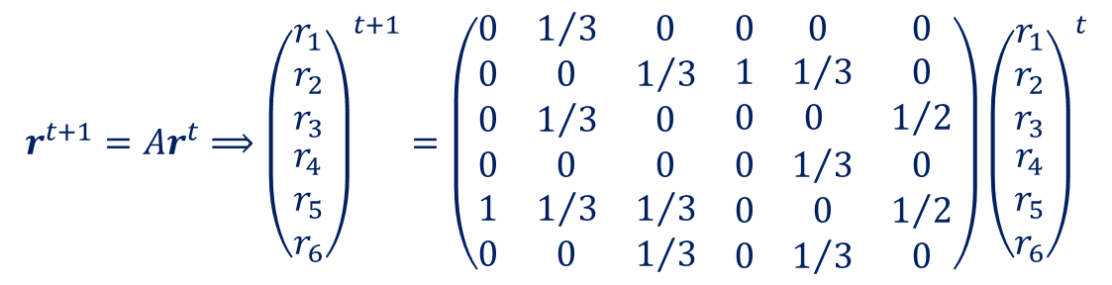
PageRank algorithm
$$r^{t+1}=Ar^{t}⟹{\left(\begin{matrix}\begin{matrix}r_{1} \\ r_{2} \\ r_{3}\end{matrix} \\ \begin{matrix}r_{4} \\ r_{5} \\ r_{6}\end{matrix}\end{matrix}\right)}^{t+1}=\left(\begin{matrix}\begin{matrix}0 & 1/3 & 0 \\ 0 & 0 & 1/3 \\ 0 & 1/3 & 0\end{matrix} & \begin{matrix}0 & 0 & 0 \\ 1 & 1/3 & 0 \\ 0 & 0 & 1/2\end{matrix} \\ \begin{matrix}0 & 0 & 0 \\ 1 & 1/3 & 1/3 \\ 0 & 0 & 1/3\end{matrix} & \begin{matrix}0 & 1/3 & 0 \\ 0 & 0 & 1/2 \\ 0 & 1/3 & 0\end{matrix}\end{matrix}\right){\left(\begin{matrix}\begin{matrix}r_{1} \\ r_{2} \\ r_{3}\end{matrix} \\ \begin{matrix}r_{4} \\ r_{5} \\ r_{6}\end{matrix}\end{matrix}\right)}^{t}$$
$$n_{1}$$
The simplified Pagerank algorithm, described as the distribution of random surfers, can
be seen as a Markov process:
The set of posible states is finite.
Next position of the random surfer depends only of the current state.
Outgoing links are chosen with equal likelihood
$$n_{2}$$
$$n_{3}$$
$$n_{4}$$
$$n_{5}$$
The probability distribution vector follows a random evolutionary process.
$r^{t+1}=Ar^{t}=$ $A\left(Ar^{t−1}\right)=…= A(A\left(…\left(Ar^{0}\right)\right)$
$$n_{6}$$
11

Slide 12
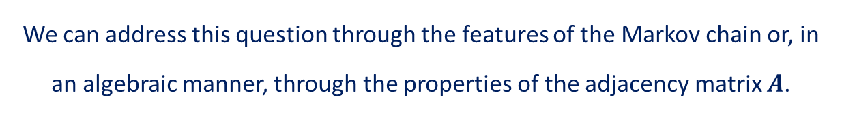

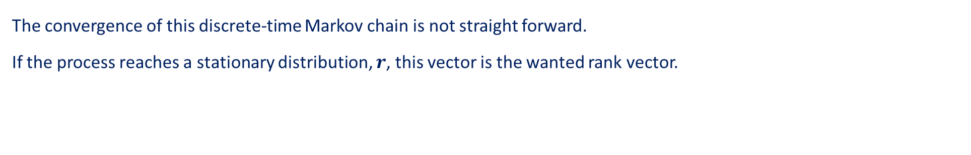
PageRank algorithm
The convergence of this discrete-time Markov chain is not straight forward.
If the process reaches a stationary distribution, $r$, this vector is the wanted rank vector.
$r^{t+1}=Ar^{t}=r^{t}⟹$ $Ar=r⟹ \left(A−I\right)r=0$
The rank vector is an eigenvector of the transition web matrix $A.$
$$n_{1}$$
But: Is the Markov chain guaranteed to converge to a stationary probability distribution?
$$n_{2}$$
$$n_{3}$$
An irreducible, positive recurrent Markov chain always has a steady distribution
A Markov chain is irreducible if there is one communicating class.
A Markov chain is positive recurrent if every state is reachable in
finite time
$$n_{4}$$
$$n_{5}$$
Strongly connected graph
$$n_{6}$$
We can address this question through the features of the Markov chain or, in an algebraic manner, through the properties of the adjacency matrix $A$.
12

Slide 13
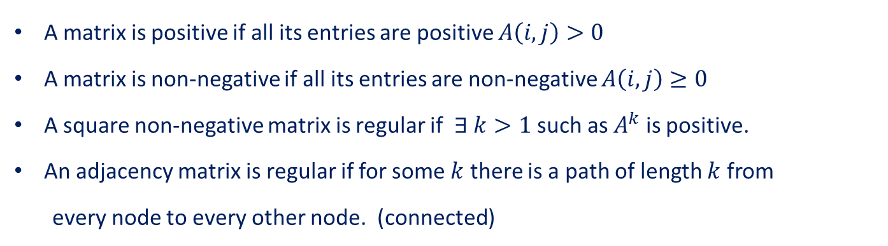
PageRank algorithm
Convergence of the Markov chain process
We can also address this question through the properties of the adjacency matrix $A$. (few definitions)
A matrix is positive if all its entries are positive $A\left(i,j\right)>0$
A matrix is non-negative if all its entries are non-negative $A\left(i,j\right)≥0$
A square non-negative matrix is regular if $∃ k>1$ such as $A^{k}$ is positive.
An adjacency matrix is regular if for some $k$ there is a path of length $k$ from
every node to every other node. (connected)
$$n_{1}$$
$$n_{2}$$
$$n_{3}$$
An adjacency matrix is a stochastic matrix if all its entries are
non-negative and the sum of entries over the columns is 1.
$$n_{4}$$
$$n_{5}$$
$$n_{6}$$
13

Slide 14

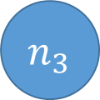
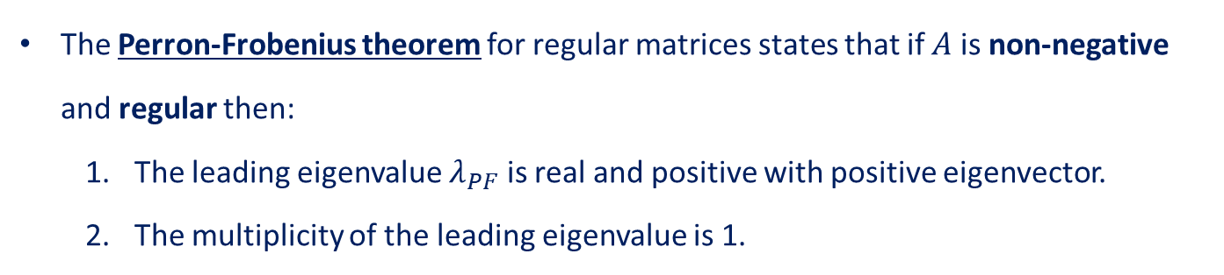

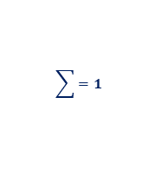

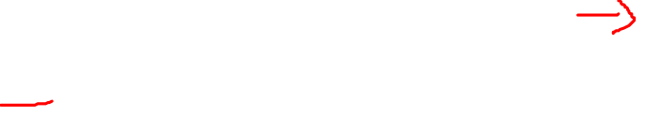
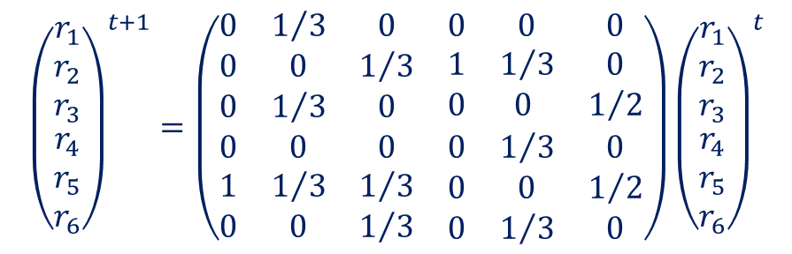
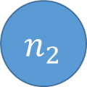

PageRank algorithm
In the example graph the adjacency matrix is regular and non-negative
$$\sum{=1}$$
$$n_{1}$$
$${\left(\begin{matrix}\begin{matrix}r_{1} \\ r_{2} \\ r_{3}\end{matrix} \\ \begin{matrix}r_{4} \\ r_{5} \\ r_{6}\end{matrix}\end{matrix}\right)}^{t+1}=\left(\begin{matrix}\begin{matrix}0 & 1/3 & 0 \\ 0 & 0 & 1/3 \\ 0 & 1/3 & 0\end{matrix} & \begin{matrix}0 & 0 & 0 \\ 1 & 1/3 & 0 \\ 0 & 0 & 1/2\end{matrix} \\ \begin{matrix}0 & 0 & 0 \\ 1 & 1/3 & 1/3 \\ 0 & 0 & 1/3\end{matrix} & \begin{matrix}0 & 1/3 & 0 \\ 0 & 0 & 1/2 \\ 0 & 1/3 & 0\end{matrix}\end{matrix}\right){\left(\begin{matrix}\begin{matrix}r_{1} \\ r_{2} \\ r_{3}\end{matrix} \\ \begin{matrix}r_{4} \\ r_{5} \\ r_{6}\end{matrix}\end{matrix}\right)}^{t}$$
$$n_{2}$$
$$n_{3}$$
$$n_{4}$$
$$n_{5}$$
The Perron-Frobenius theorem for regular matrices states that if $A$ is non-negative and regular then:
The leading eigenvalue $λ_{PF}$ is real and positive with positive eigenvector.
The multiplicity of the leading eigenvalue is 1.
$$n_{6}$$
Existence and uniqueness of solution
$$Ar=λ_{PF}r⟹ \left(A−λ_{PF}I\right)r=0$$
14

Slide 15
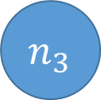
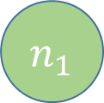
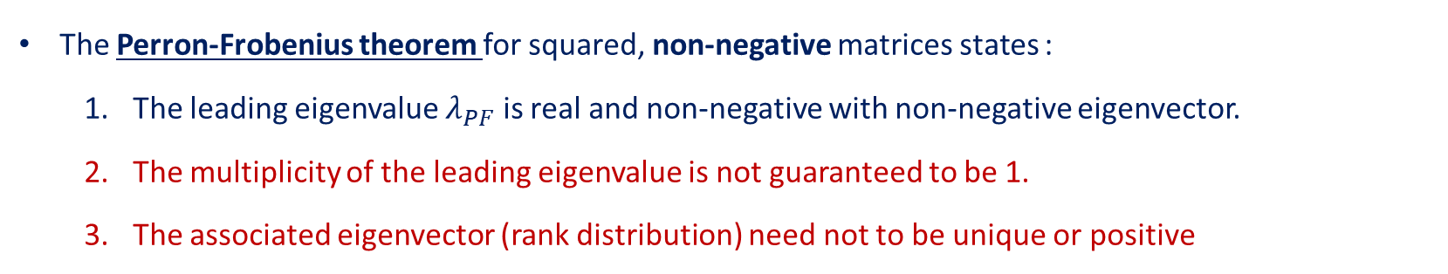

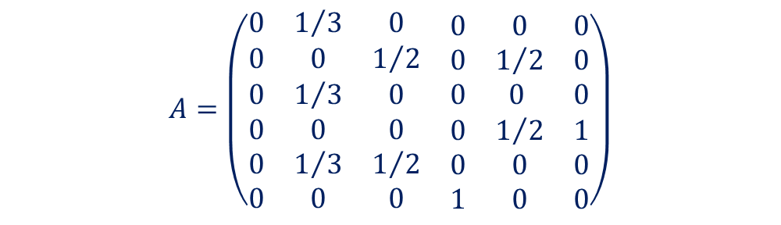


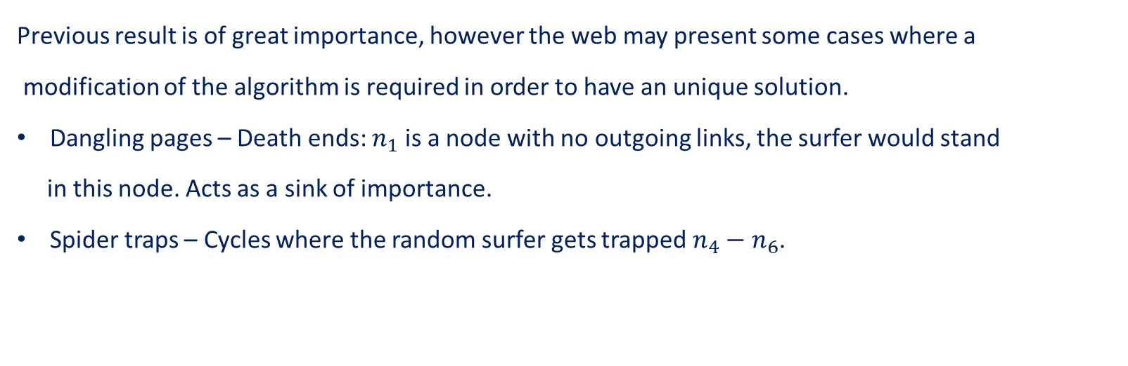


PageRank algorithm
Previous result is of great importance, however the web may present some cases where a
modification of the algorithm is required in order to have an unique solution.
Dangling pages – Death ends: $n_{1}$ is a node with no outgoing links, the surfer would stand
in this node. Acts as a sink of importance.
Spider traps – Cycles where the random surfer gets trapped $n_{4}−n_{6}$.
$$n_{1}$$
$$n_{2}$$
$$n_{3}$$
$$A=\left(\begin{matrix}\begin{matrix}0 & 1/3 & 0 \\ 0 & 0 & 1/2 \\ 0 & 1/3 & 0\end{matrix} & \begin{matrix}0 & 0 & 0 \\ 0 & 1/2 & 0 \\ 0 & 0 & 0\end{matrix} \\ \begin{matrix}0 & 0 & 0 \\ 0 & 1/3 & 1/2 \\ 0 & 0 & 0\end{matrix} & \begin{matrix}0 & 1/2 & 1 \\ 0 & 0 & 0 \\ 1 & 0 & 0\end{matrix}\end{matrix}\right)$$
$$n_{5}$$
Adiacency matrix becomes singular, no stochastic.
$$n_{4}$$
$$n_{6}$$
The Perron-Frobenius theorem for squared, non-negative matrices states :
The leading eigenvalue $λ_{PF}$ is real and non-negative with non-negative eigenvector.
The multiplicity of the leading eigenvalue is not guaranteed to be 1.
The associated eigenvector (rank distribution) need not to be unique or positive
15

Slide 16

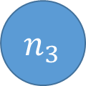




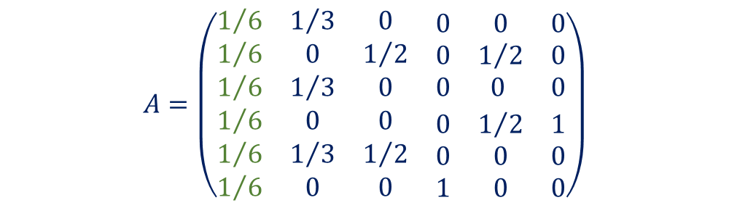


PageRank algorithm
Addresing “problems”:
In a dead-end the surfer explicitly teleports with equal probability to another page.
We asume dangling nodes points to every node in the graph.
$$n_{1}$$
$$n_{2}$$
$$n_{3}$$
$$A=\left(\begin{matrix}\begin{matrix}1/6 & 1/3 & 0 \\ 1/6 & 0 & 1/2 \\ 1/6 & 1/3 & 0\end{matrix} & \begin{matrix}0 & 0 & 0 \\ 0 & 1/2 & 0 \\ 0 & 0 & 0\end{matrix} \\ \begin{matrix}1/6 & 0 & 0 \\ 1/6 & 1/3 & 1/2 \\ 1/6 & 0 & 0\end{matrix} & \begin{matrix}0 & 1/2 & 1 \\ 0 & 0 & 0 \\ 1 & 0 & 0\end{matrix}\end{matrix}\right)$$
Adjacency matrix recovers stochasticity.
$$n_{5}$$
$$r_{j}^{t+1}=\sum_{i→j}{\frac{r_{i}^{t}}{d_{i}}}+ \sum_{k}{\frac{r_{k}^{t}}{N}}$$
$$n_{4}$$
$$n_{6}$$
For all $n_{k}$ dangling nodes

Slide 17
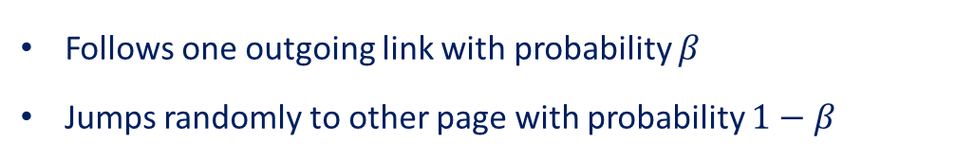
PageRank algorithm
Addresing “problems”:
In a dead-end the surfer explicitly teleports with equal probability to another page.
We asume dangling nodes points to every node in the graph.
$$n_{1}$$
$$n_{2}$$
$$n_{3}$$
$$A=\left(\begin{matrix}\begin{matrix}1/6 & 1/3 & 0 \\ 1/6 & 0 & 1/2 \\ 1/6 & 1/3 & 0\end{matrix} & \begin{matrix}0 & 0 & 0 \\ 0 & 1/2 & 0 \\ 0 & 0 & 0\end{matrix} \\ \begin{matrix}1/6 & 0 & 0 \\ 1/6 & 1/3 & 1/2 \\ 1/6 & 0 & 0\end{matrix} & \begin{matrix}0 & 1/2 & 1 \\ 0 & 0 & 0 \\ 1 & 0 & 0\end{matrix}\end{matrix}\right)$$
Adiacency matrix recovers stochasticity.
$$n_{5}$$
To deal with “spider-traps” or more of one connected component, in every step the
random surfer may:
$$n_{4}$$
$$n_{6}$$
Follows one outgoing link with probability $β$
Jumps randomly to other page with probability $1−β$

Slide 18




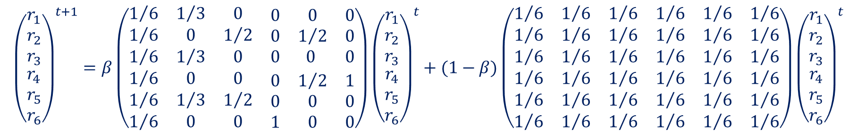

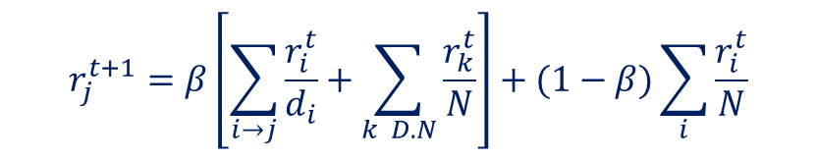


PageRank algorithm
The equation for the page rank transforms into:
$$n_{1}$$
$$r_{j}^{t+1}=β\left[\sum_{i→j}{\frac{r_{i}^{t}}{d_{i}}}+\sum_{k D.N}{\frac{r_{k}^{t}}{N}}\right]+(1−β)\sum_{i}{\frac{r_{i}^{t}}{N}}$$
$$n_{2}$$
$$n_{3}$$
$$n_{5}$$
In the example graph
$$n_{4}$$
$$n_{6}$$
$${\left(\begin{matrix}\begin{matrix}r_{1} \\ r_{2} \\ r_{3}\end{matrix} \\ \begin{matrix}r_{4} \\ r_{5} \\ r_{6}\end{matrix}\end{matrix}\right)}^{t+1}=β\left(\begin{matrix}\begin{matrix}1/6 & 1/3 & 0 \\ 1/6 & 0 & 1/2 \\ 1/6 & 1/3 & 0\end{matrix} & \begin{matrix}0 & 0 & 0 \\ 0 & 1/2 & 0 \\ 0 & 0 & 0\end{matrix} \\ \begin{matrix}1/6 & 0 & 0 \\ 1/6 & 1/3 & 1/2 \\ 1/6 & 0 & 0\end{matrix} & \begin{matrix}0 & 1/2 & 1 \\ 0 & 0 & 0 \\ 1 & 0 & 0\end{matrix}\end{matrix}\right){\left(\begin{matrix}\begin{matrix}r_{1} \\ r_{2} \\ r_{3}\end{matrix} \\ \begin{matrix}r_{4} \\ r_{5} \\ r_{6}\end{matrix}\end{matrix}\right)}^{t}+(1−β)\left(\begin{matrix}\begin{matrix}1/6 & 1/6 & 1/6 \\ 1/6 & 1/6 & 1/6 \\ 1/6 & 1/6 & 1/6\end{matrix} & \begin{matrix}1/6 & 1/6 & 1/6 \\ 1/6 & 1/6 & 1/6 \\ 1/6 & 1/6 & 1/6\end{matrix} \\ \begin{matrix}1/6 & 1/6 & 1/6 \\ 1/6 & 1/6 & 1/6 \\ 1/6 & 1/6 & 1/6\end{matrix} & \begin{matrix}1/6 & 1/6 & 1/6 \\ 1/6 & 1/6 & 1/6 \\ 1/6 & 1/6 & 1/6\end{matrix}\end{matrix}\right){\left(\begin{matrix}\begin{matrix}r_{1} \\ r_{2} \\ r_{3}\end{matrix} \\ \begin{matrix}r_{4} \\ r_{5} \\ r_{6}\end{matrix}\end{matrix}\right)}^{t}$$
18

Slide 19
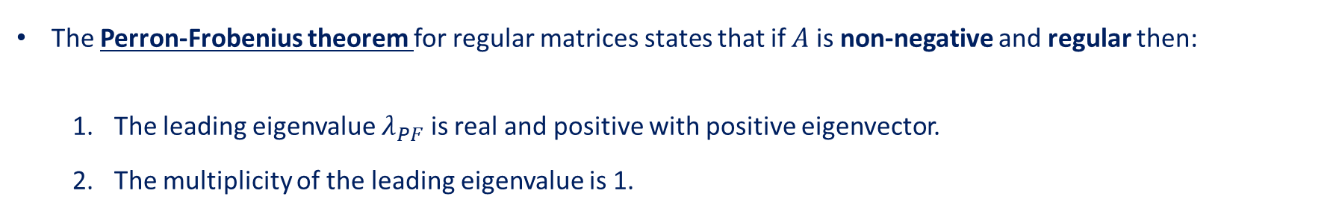


PageRank algorithm
The formula may be rewritten more schematically:
$$r^{t+1}=βAr^{t}+(1−β)\hat{A}r^{t}$$
Or:
$$r^{t+1}=\tilde{A}r^{t}$$
Where $\tilde{A}$ is a stochastic, regular, positive matrix.
The Perron-Frobenius theorem for regular matrices states that if $A$ is non-negative and regular then:
The leading eigenvalue $λ_{PF}$ is real and positive with positive eigenvector.
The multiplicity of the leading eigenvalue is 1.
Existence and uniqueness of solution
Stochasticity and the strictly positive character of matrix $\tilde{A}$ adds an essential point:
The unique leading eigenvalue is $λ_{PF}=1$ and its corresponding eigenvector is the pagerank probability vector.
$$r=\tilde{A}r⟺\left(\tilde{A}−I\right)r=0$$
19

Slide 20
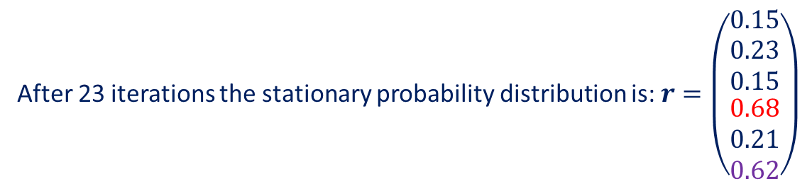

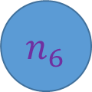

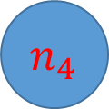


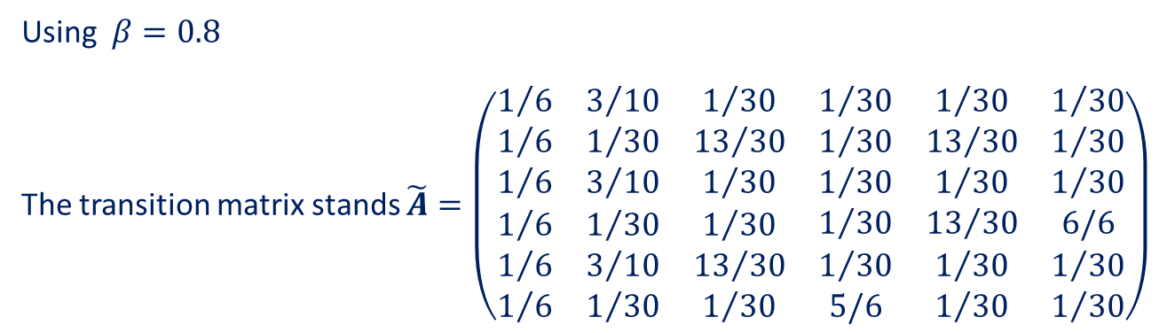
PageRank algorithm
Examples
Using $β=0.8$
The transition matrix stands $\tilde{A}=\left(\begin{matrix}\begin{matrix}1/6 & 3/{10} & 1/{30} \\ 1/6 & 1/{30} & {13}/{30} \\ 1/6 & 3/{10} & 1/{30}\end{matrix} & \begin{matrix}1/{30} & 1/{30} & 1/{30} \\ 1/{30} & {13}/{30} & 1/{30} \\ 1/{30} & 1/{30} & 1/{30}\end{matrix} \\ \begin{matrix}1/6 & 1/{30} & 1/{30} \\ 1/6 & 3/{10} & {13}/{30} \\ 1/6 & 1/{30} & 1/{30}\end{matrix} & \begin{matrix}1/{30} & {13}/{30} & 6/6 \\ 1/{30} & 1/{30} & 1/{30} \\ 5/6 & 1/{30} & 1/{30}\end{matrix}\end{matrix}\right)$
$$n_{1}$$
$$n_{2}$$
$$n_{3}$$
After 23 iterations the stationary probability distribution is: $r=\left(\begin{matrix}\begin{matrix}0.15 \\ 0.23 \\ 0.15\end{matrix} \\ \begin{matrix}0.68 \\ 0.21 \\ 0.62\end{matrix}\end{matrix}\right)$
$$n_{5}$$
$$n_{4}$$
$$n_{6}$$
20

Slide 21

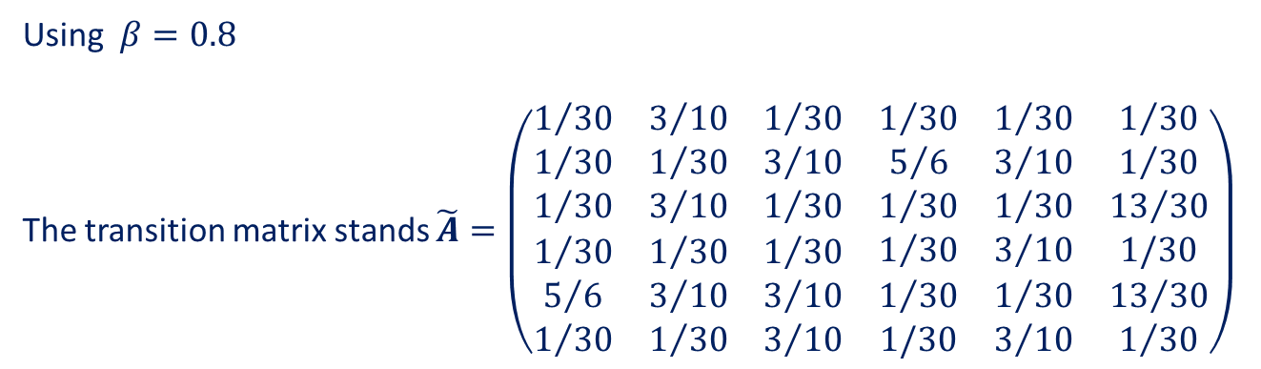
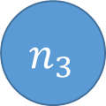
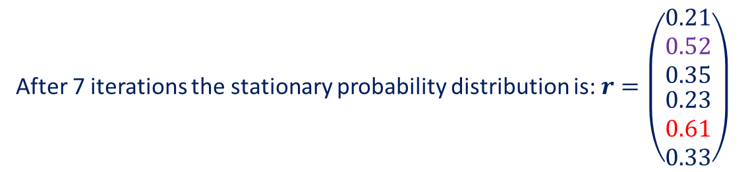


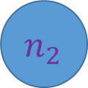

PageRank algorithm
Examples
Using $β=0.8$
The transition matrix stands $\tilde{A}=\left(\begin{matrix}\begin{matrix}1/{30} & 3/{10} & 1/{30} \\ 1/{30} & 1/{30} & 3/{10} \\ 1/{30} & 3/{10} & 1/{30}\end{matrix} & \begin{matrix}1/{30} & 1/{30} & 1/{30} \\ 5/6 & 3/{10} & 1/{30} \\ 1/{30} & 1/{30} & {13}/{30}\end{matrix} \\ \begin{matrix}1/{30} & 1/{30} & 1/{30} \\ 5/6 & 3/{10} & 3/{10} \\ 1/{30} & 1/{30} & 3/{10}\end{matrix} & \begin{matrix}1/{30} & 3/{10} & 1/30 \\ 1/{30} & 1/{30} & {13}/{30} \\ 1/30 & 3/{10} & 1/{30}\end{matrix}\end{matrix}\right)$
$$n_{1}$$
$$n_{2}$$
$$n_{3}$$
After 7 iterations the stationary probability distribution is: $r=\left(\begin{matrix}\begin{matrix}0.21 \\ 0.52 \\ 0.35\end{matrix} \\ \begin{matrix}0.23 \\ 0.61 \\ 0.33\end{matrix}\end{matrix}\right)$
$$n_{4}$$
$$n_{5}$$
$$n_{6}$$
21

