Slide 1


Eigenvalue Problems in Engineering
with application to fluid dynamics
Training Event
December 2021
Universidad Politécnica de Madrid
SSeCoID: Stability and Sensitivity Methods for Flow Control and Industrial Design

Slide 2

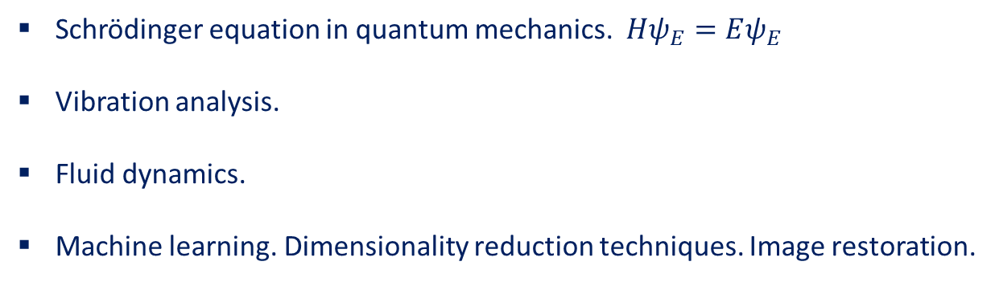
Introduction. Eigenvalue Problems
Eigenvalue Problems appear in different fields of sciences.
Schrödinger equation in quantum mechanics. $Hψ_{E}=Eψ_{E}$
Vibration analysis.
Fluid dynamics.
Machine learning. Dimensionality reduction techniques. Image restoration.
Questions
Eigenvalue Problems are challenging. Around 40% papers in SIAM J. on Matrix Analysis and Applications are related to eigenvalue problem research.
Am I interested in all the solutions of the Eigenvalue Problem?
If I am looking for specific eigenvalues. Which ones do I require?
Is the matrix real or complex?
What special properties does the matrix have?

Slide 3

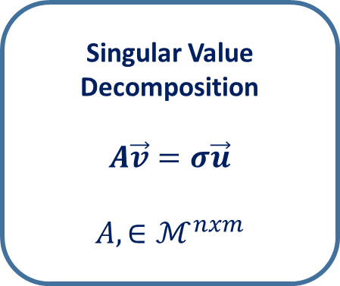
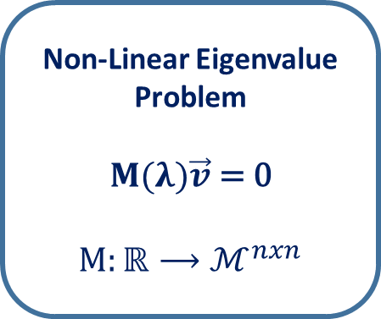
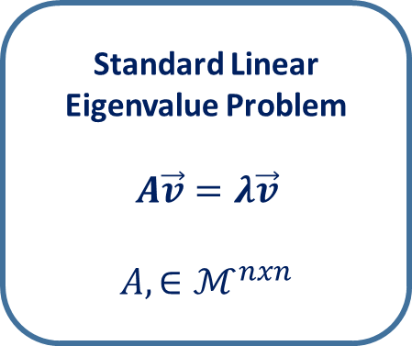
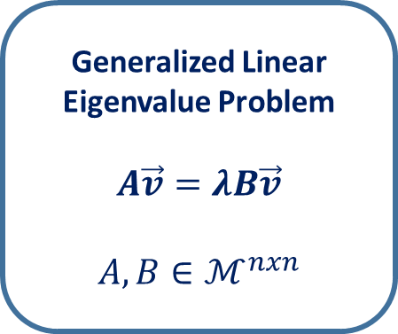
Introduction. Eigenvalue Problem Classification
Standard Linear Eigenvalue Problem
$$A\vec{v}=λ\vec{v}$$
$$A, ∈ℳ^{nxn}$$
Generalized Linear Eigenvalue Problem
$$A\vec{v}=λB\vec{v}$$
$$A, B∈ℳ^{nxn}$$
Non-Linear Eigenvalue Problem
$$M(λ)\vec{v}\text{ =} \text{0}$$
$$M:ℝ⟶ℳ^{nxn}$$
Singular Value Decomposition
$$A\vec{v}=σ\vec{u}$$
$$A, ∈ℳ^{nxm}$$
Example: Low vibration systems in n-dimensions are described by $M\ddot{x}+C\dot{x}+Kx=0$ where $M$ is mass matrix, $C$ is viscous damping matrix, and $K$ is the stiffness matrix. Considering $x=\vec{v}e^{ωt}$ leads to the Quadratic Eigenvalue Problem:
$${(ω}^{2}M+ωC+K)\vec{v}=0$$

Slide 4
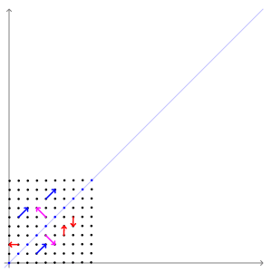
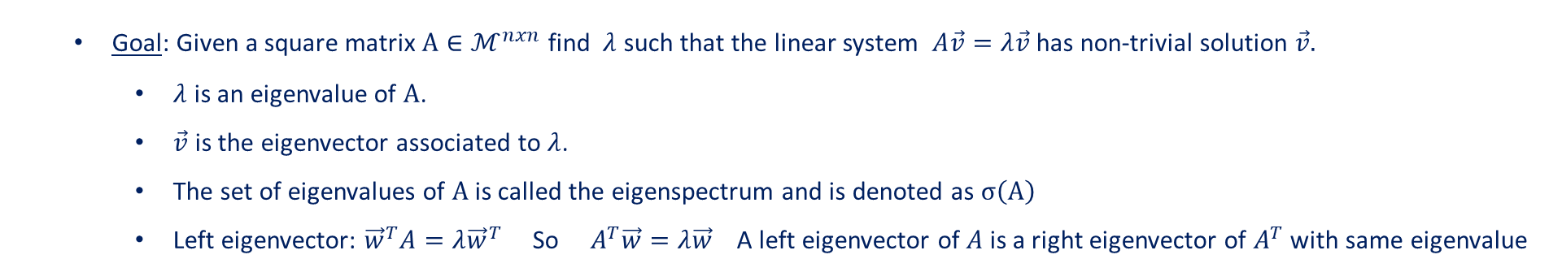

Introduction. Linear Eigenvalue Problem
Goal: Given a square matrix $A∈ℳ^{nxn}$ find $λ$ such that the linear system $A\vec{v}=λ\vec{v}$ has non-trivial solution $\vec{v}.$
$λ$ is an eigenvalue of $A$.
$\vec{v}$is the eigenvector associated to $λ$.
The set of eigenvalues of $A$ is called the eigenspectrum and is denoted as $σ\left(A\right)$
Left eigenvector: ${\vec{w}}^{T}A=λ{\vec{w}}^{T}$ So $A^{T}\vec{w}=λ\vec{w}$ A left eigenvector of $A$ is a right eigenvector of $A^{T}$ with same eigenvalue
Eigenvectors determines 1-dimensional invariant subspaces of the linear transformation $A$.
Matrix $A=\left(\begin{matrix}2 & 1 \\ 1 & 2\end{matrix}\right)$ fulfills $\begin{matrix}\left(\begin{matrix}2 & 1 \\ 1 & 2\end{matrix}\right)\left(\begin{matrix}1 \\ 1\end{matrix}\right)=3\left(\begin{matrix}1 \\ 1\end{matrix}\right) \\ \left(\begin{matrix}2 & 1 \\ 1 & 2\end{matrix}\right)\left(\begin{matrix}1 \\ −1\end{matrix}\right)=1\left(\begin{matrix}1 \\ −1\end{matrix}\right)\end{matrix}$
Blue eigenvector, ${\vec{v}}_{1}=\left(\begin{matrix}1 \\ 1\end{matrix}\right),$ is amplified (3x) when $A$ is applied but keeps its direction.
Pink eigenvector, ${\vec{v}}_{2}=\left(\begin{matrix}1 \\ −1\end{matrix}\right)$, is mapped to itself by $A$.
Red vectors are linearly transformed by $A$.

Slide 5


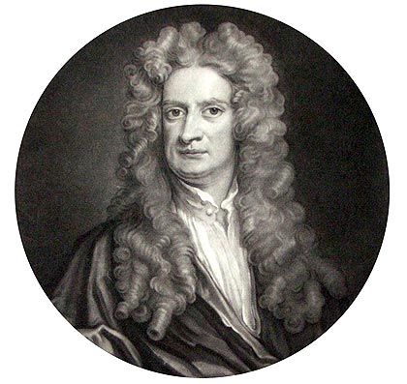


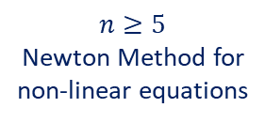


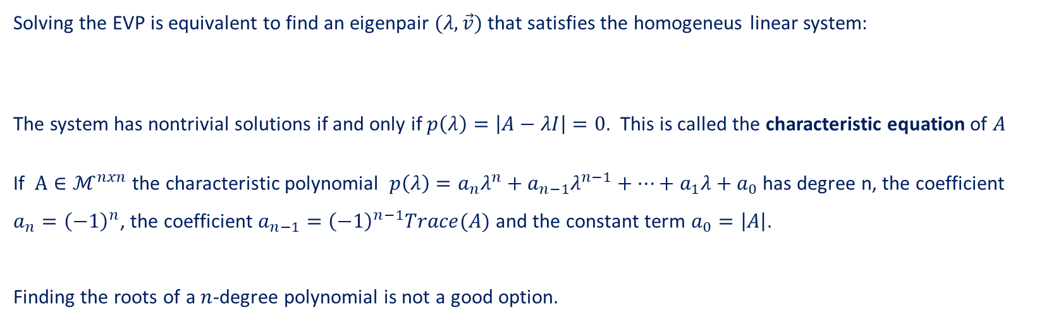

Introduction. Mathematical approach to the Linear Eigenvalue Problem (EVP).
Goal: Given a square matrix $A∈ℳ^{nxn}$ find $λ$ such that the linear system $A\vec{v}=λ\vec{v}$ has non-trivial solution $\vec{v}.$
Solving the EVP is equivalent to find an eigenpair $(λ,\vec{v})$ that satisfies the homogeneus linear system:
The system has nontrivial solutions if and only if $p\left(λ\right)=\left|A−λI\right|=0$. This is called the characteristic equation of $A$
If $A∈ℳ^{nxn}$ the characteristic polynomial $p\left(λ\right)=a_{n}λ^{n}+a_{n−1}λ^{n−1}+…+a_{1}λ+a_{0}$ has degree n, the coefficient $a_{n}={\left(−1\right)}^{n}$, the coefficient $a_{n−1}={\left(−1\right)}^{n−1}Trace(A)$ and the constant term $a_{0}=\left|A\right|$.
Finding the roots of a $n$-degree polynomial is not a good option.
$$A\vec{v}−λ\vec{v}=0≡\left(A−λI\right)\vec{v}=0$$
$$n=3$$
Cardano formula
$$n=4$$
Descartes formula
$n≥5$
Newton Method for non-linear equations

Slide 6
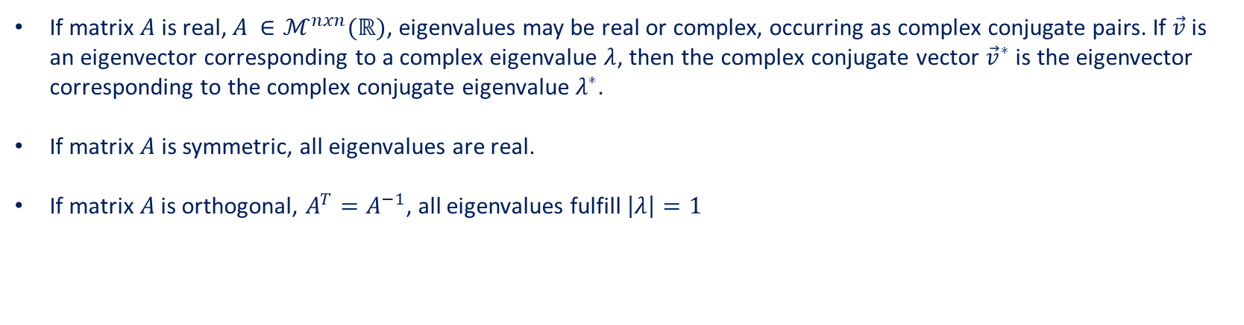
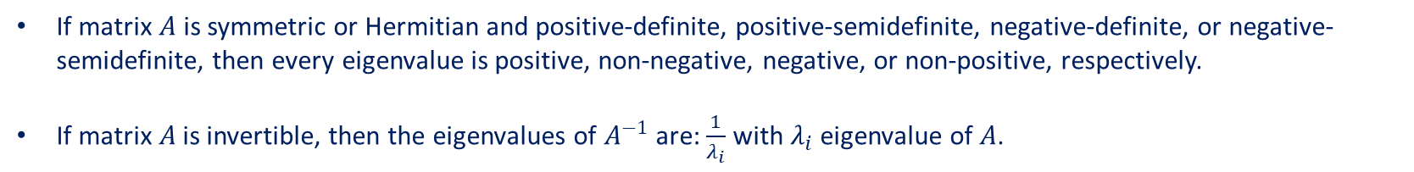


Introduction. Mathematical approach to the Linear Eigenvalue Problem (EVP).
If matrix $A$is real, $A ∈ℳ^{nxn}(ℝ)$, eigenvalues may be real or complex, occurring as complex conjugate pairs. If $\vec{v}$ is an eigenvector corresponding to a complex eigenvalue $λ$, then the complex conjugate vector ${\vec{v}}^{∗}$ is the eigenvector corresponding to the complex conjugate eigenvalue $λ^{∗}$.
If matrix $A$is symmetric, all eigenvalues are real.
If matrix $A$ is orthogonal, $A^{T}=A^{−1}$, all eigenvalues fulfill $\left|λ\right|=1$
Real Matrix
$A ∈ℳ^{nxn}(ℝ)$
If matrix $A$is Hermitian, $A^{∗}=A$, $(A_{ij}^{∗}={\overline{A}}_{ji}$ $A^{∗}$ conjugate transpose matrix ) all eigenvalues are real.
If matrix $A$ is unitary, $A^{∗}=A^{−1}$, all eigenvalues fulfill $\left|λ\right|=1$
Complex Matrix
$$A ∈ℳ^{nxn}(ℂ)$$
If matrix $A$is symmetric or Hermitian and positive-definite, positive-semidefinite, negative-definite, or negative-semidefinite, then every eigenvalue is positive, non-negative, negative, or non-positive, respectively.
If matrix $A$ is invertible, then the eigenvalues of $A^{−1}$ are: $\frac{1}{λ_{i}}$ with $λ_{i}$ eigenvalue of $A$.

Slide 7
Introduction. Outline
Introduction to the Eigenvalue Problem.
Three significant Eigenvalue Problems:
Google Pagerank Algorithm.
Principal Component Analysis.
Global Stability Analysis.
Numerical Methods for Eigenvalue Problems.
Single Vector Iteration Methods.
Full Spectrum Computation.
Subspace Projection Methods.

